Slide 1
EE307 Topic 2: Complementary MOSFET inverter details
Part 1:
Inverter static and dynamic metrics

Slide 2
Practice
Find complex gate circuits for these equations

Slide 3
Overview of topic 2
You should now feel OK designing complementary MOSFET complex circuits.
Now we’ll see:
DC and dynamic characteristics
What a good digital circuit looks like
How to put numbers to describe a digital circuit (metrics)
Find speed and power of a digital circuit
We’ll use the simplest complementary MOSFET circuit in this analysis: an inverter.

Slide 4
DC Characteristics

Slide 5
DC means no time involved
Simulation types for DC metrics:
DC bias point (.op)
DC bias point (.op) puts DC value on input and, after everything settles tells you what the node voltages are and what branch currents are for that SINGLE DC input
DC sweep:
DC sweep puts DC value on input and, after everything settles tells you what the node voltages are and what branch currents are
Does this for a set of inputs and them connects the dots
NO TIME INVOLVED
Capacitors open circuited
Inductors shorted

Slide 6
Vocabulary for DC description/metrics of (digital) circuits

Slide 7
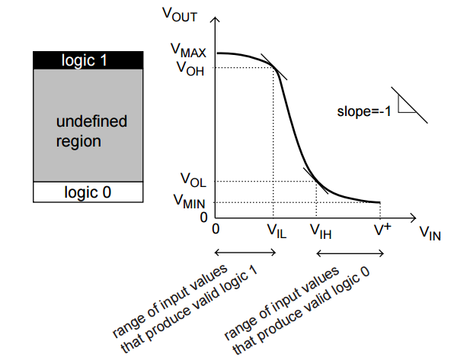
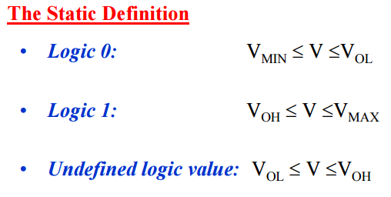
Language of digital circuits
Terms used to describe performance (static=DC)
Vm : Vin=Vout
Vmax, Vmin , VOH, VOL, VIH, VIL, NM_{H}, NM_{L}
Vm

Slide 8
NM_{H} and NM_{L} tell you:
NM = Noise margin
NM_{H} = Noise margin high
NM_{L} = Noise margin low
And tell you:
How robust a digital circuit is to noise
How much noise you can have on a circuit and still get the right answer

Slide 9
Noise types
GND/Supply noise:
Current rushing on and off of GND and power plane
Signal noise:
Capacitive coupling
IR drop
Intrinsic noise
Current doesn't flow smoothly
Many digital logic families cause A LOT of GND and supply noise. They need to be robust.

Slide 10
Bypass Capacitors (2) Noisy signals

Slide 11
Inductive supply noise
GND or VDD/VCC has a bunch of charge removed (added)
To get GND or VDD/VCC back to where it should be there is a rush of charge on to (off of) GND/VDD/VCC
The current induces a magnetic field = induction
Even after GND/VDD/VCC reaches its correct value, the current doesn’t stop
= More bouncing…

Slide 12
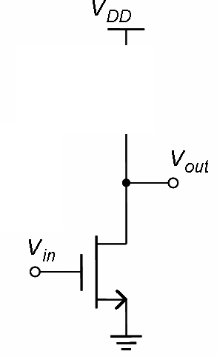
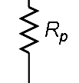
Where does noise on the signal line come from?
Capacitive coupling from nearby wire or E&M transmision (cell phone, computer, etc)
_{D}
v_{in}
v_{in}
~
+
--
1V
60Hz noise and high-frequency noise common

Slide 13
Where does supply (VDD, VCC, GND) noise come from?
Digital (synchronous) systems suck electrons off GND each time the clock ticks
Removing negative charge makes GND a little more positive until electrons can be restored
At high frequencies, inductance can be a factor and the rush of electrons to restore the electrons on GND plane can cause overshoot and temporarily make GND more negative than it should be
Digital (synchronous) systems dump electrons onto VDD/VCC each time the clock ticks
Same effects as above
Same causes as signal noise

Slide 14
Intrinsic Noise
Shot noise: Associated with DC current flow. Present in diodes, BJTs and MOSFETs. The random pace at which electrons jump across depletion region.
Thermal noise: Thermal motion of electrons. Directly proportional to T. Nothing to do with current.
Flicker (1/f) noise: Traps caused by contamination of silicon and crystal defects.
Burst (popcorn) noise: Source unknown – might be from heavy metal ion contamination.
Avalanche noise: Avalanche breakdown in pn junction. Holes and electron pairs acquire sufficient energy to create pairs upon colliding with silicon atoms.

Slide 15
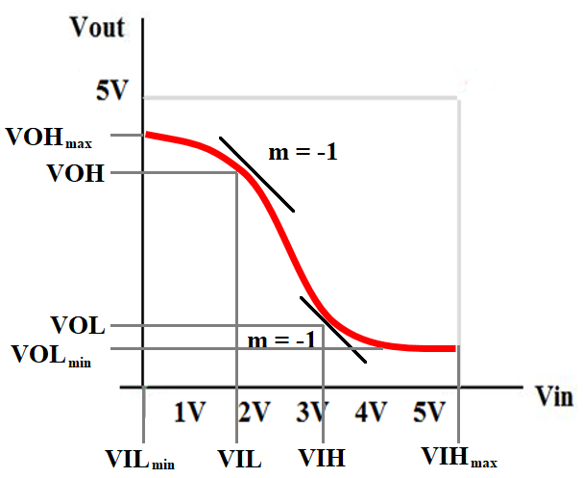
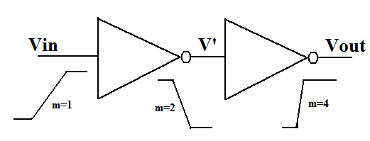
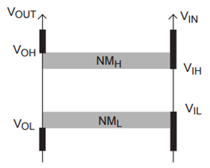
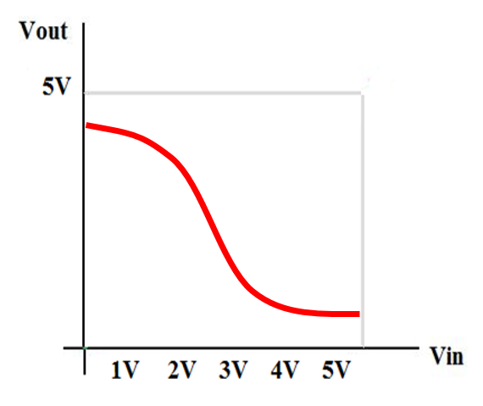
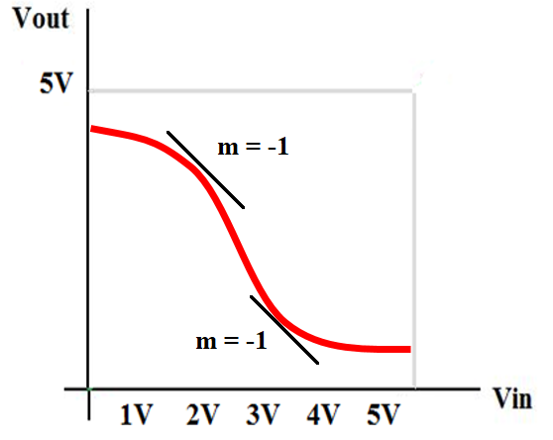
NM_{H}, NM_{L}: Noise margins
2x
2x
Inverter 1
Inverter 2
VIL_{min} VIL VIH VIH_{max}
VOL_{min} VOL VOH VOH_{max}
V’
VOHmax
VOLmax
Noise margin equations:
Noise margin (low):
NML=VIL - VOLmin
Noise margin (high):
NMH=VOHmax - VIH

Slide 16
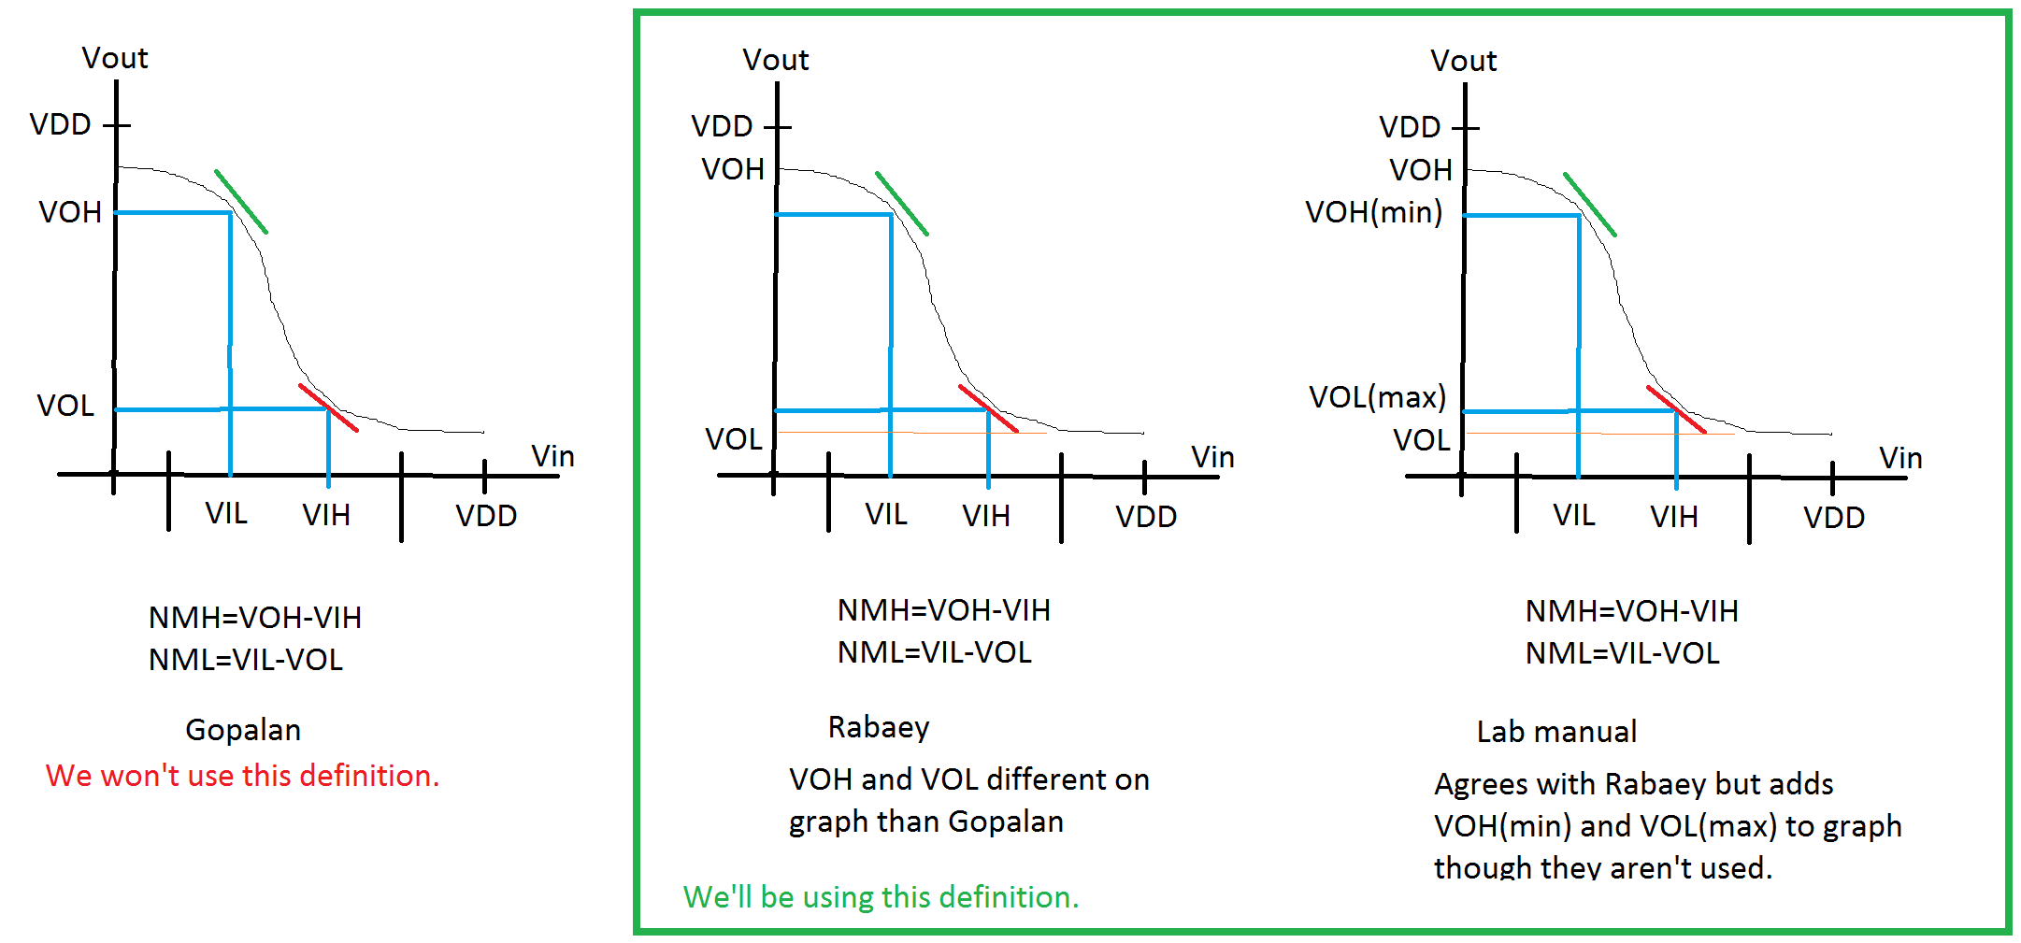
NOTE: Definition of NM_{H}, NM_{L} vary
Different books and websites define NM_{H} and NM_{L} differently.
Gopalan uses different definition.

Slide 17
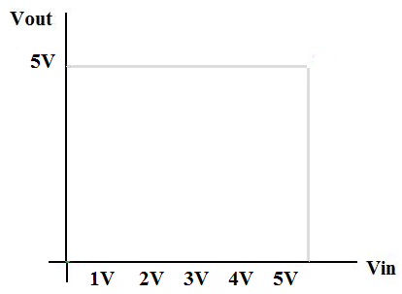
NM_{H}, NM_{L}: Noise margins (1)
VIL
2x
2x
Inverter 2
VIH
Inverter 2
Inverter 1
VOHmax
VOLmax
Inverter 1
VOHmax
Noise margin equations:
Noise margin (low):
NML=VIL - VOLmin
VOLmin
Noise margin (high):
NMH=VOHmax - VIH

Slide 18
Summary of digital circuit metrics

Slide 19
Summary of digital circuit metrics
Terms used to describe performance (static=DC)
Vm : Vin=Vout
Vmax, Vmin , VOH, VOL, VIH, VIL, NM_{H}, NM_{L}
Vm

Slide 20
ON or OFF

Slide 21
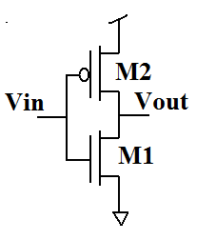
Analysis 1/2: What’s on?
Vin | VGS_{N} | VGS_{P} | M1 | M2
0 | 0 | -3.3 | X | O
0.2 | 0.2 | -3.1 | X | O
0.4 | 0.4 | -2.9 | X | O
0.5 | 0.5 | -2.8 | o | O
0.6 | 0.6 | -2.7 | O | O
1.5 | 1.5 | -1.8 | O | O
2.1 | 2.1 | -1.2 | O | O
2.7 | 2.7 | -0.6 | O | o
3.0 | 3.0 | -0.3 | O | X
3.3 | 3.3 | -0.0 | O | X
ON/OFF graph:
Vin on X-axis
ON/OFF on Y-axis
Example 1:
(Add line for M1 and M2 )
VTN = 0.5V, VTP = -0.6V, VDD = 3.3V
ON
Vout Pulled up
Short circuit current
Vout Pulled down
Vin | Vout
0 | 1
1 | 0
NOTE: VDD > VTN + |VTP|
What’s width of the SS section?
OFF
VDD – (VTN + |VTP|)=Width
Vin
0 0.5 1.0 1.5 2.0 2.5 3.0 3.5

Slide 22
Analysis 2/2: What’s on?
ON/OFF graph:
Vin on X-axis
ON/OFF on Y-axis
Example 1: (Add line for M1 and M2 )
VTN = 0.5V, VTP = -0.6V, VDD = 1V
(VTN + |VTP|)-VDD =Width
What happens in that center section?
ON
Vout Pulled up
Open circuit
Vout Pulled down
OFF
Vin
0 0.2 0.4 0.6 0.8 1.0 1.2

Slide 23
Regions of operation

Slide 24
Regions of operation 1/5: Transfer characteristics
Graph that has Vin on X-axis and Vout on Y-axis.
VTN = 0.75V, VTP = -0.8V, VDD = 3.3V
S_{P}
Vout
G_{P}
G_{N}
S_{N}
0 0.5 1.0 1.5 2.0 2.5 3.0 3.5
Vin
0 0.5 1.0 1.5 2.0 2.5 3.0 3.5

Slide 25
Regions of operation 2/5: Transfer characteristics
Graph that has Vin on X-axis and Vout on Y-axis.
VTN = 0.75V, VTP = -0.8V, VDD = 3.3V
Vout
Vout Pulled up.
M2 on
Short circuit current
0 0.5 1.0 1.5 2.0 2.5 3.0 3.5
Vout Pulled down.
M1 on
Vin
0 0.5 1.0 1.5 2.0 2.5 3.0 3.5

Slide 26
(Voltage) Transfer characteristic: VTC
A description of what happens to Vout when Vin is changed
Has nothing to do with time
“When you give the circuit a Vin value, what is the Vout value after the circuit has been given time to settle? Draw that point. Then give it a different Vin value and find Vout. Draw that point. Repeat a million time then connect all the points into a curve. That’s a VTC”
DC sweep simulation
Has nothing to do with time
DC sweep simulation

Slide 27
Regions of operation 3/5: Transfer characteristics M1
Graph that has Vin on X-axis and Vout on Y-axis.
VTN = 0.75V, VTP = -0.8V, VDD = 3.3V
Vout Pulled down.
M1 on
Vin=Vout
Vout
(VDS)
Vout Pulled up.
M2 ON
Short circuit current
VTN
VGSN > 0.75
VGSN – VTN = Vin – 0.75V
VGSN < 0.75
VGS-VT=VDS
Vin-VT=Vout
M1 in cutoff
VDS = Vout
0 0.5 1.0 1.5 2.0 2.5 3.0 3.5
M1 in saturation
Vm
VGSN > 0.75
Vin – 0.75V < Vout
Vin – 0.75V > Vout
Vin < Vout + 0.75V
Vin
(VGS)
M1 in linear
M1 in linear
0 0.5 1.0 1.5 2.0 2.5 3.0 3.5

Slide 28
Regions of operation 4/5: Transfer characteristics M2
Graph that has Vin on X-axis and Vout on Y-axis.
VTN = 0.75V, VTP = -0.8V, VDD = 3.3V
Vout Pulled up.
M2 ON
Short circuit current
VTP
Vout
|VGSP| - |VTP| = |VDSP|
VDD - Vin – 0.8 = VDD – Vout
Vin-0.8=Vout
Vin=Vout+0.8
0 0.5 1.0 1.5 2.0 2.5 3.0 3.5
Vout Pulled down.
M1 on
M2 in linear
M2 in linear
M2 in saturation
M2 in cutoff
Vin
0 0.5 1.0 1.5 2.0 2.5 3.0 3.5

Slide 29
Regions of operation 5/5: Transfer characteristics M2
Graph that has Vin on X-axis and Vout on Y-axis.
VTN = 0.75V, VTP = -0.8V, VDD = 3.3V
Vout
Short circuit current
Worst short circuit current
Short circuit current
Vout Pulled up.
M2 ON
Vout Pulled down.
M1 on
M1 in cutoff
M1 in saturation
0 0.5 1.0 1.5 2.0 2.5 3.0 3.5
M1 in linear
M2 in linear
When are transistors on?
M2 in saturation
M2 in cutoff
Vin
0 0.5 1.0 1.5 2.0 2.5 3.0 3.5

Slide 30
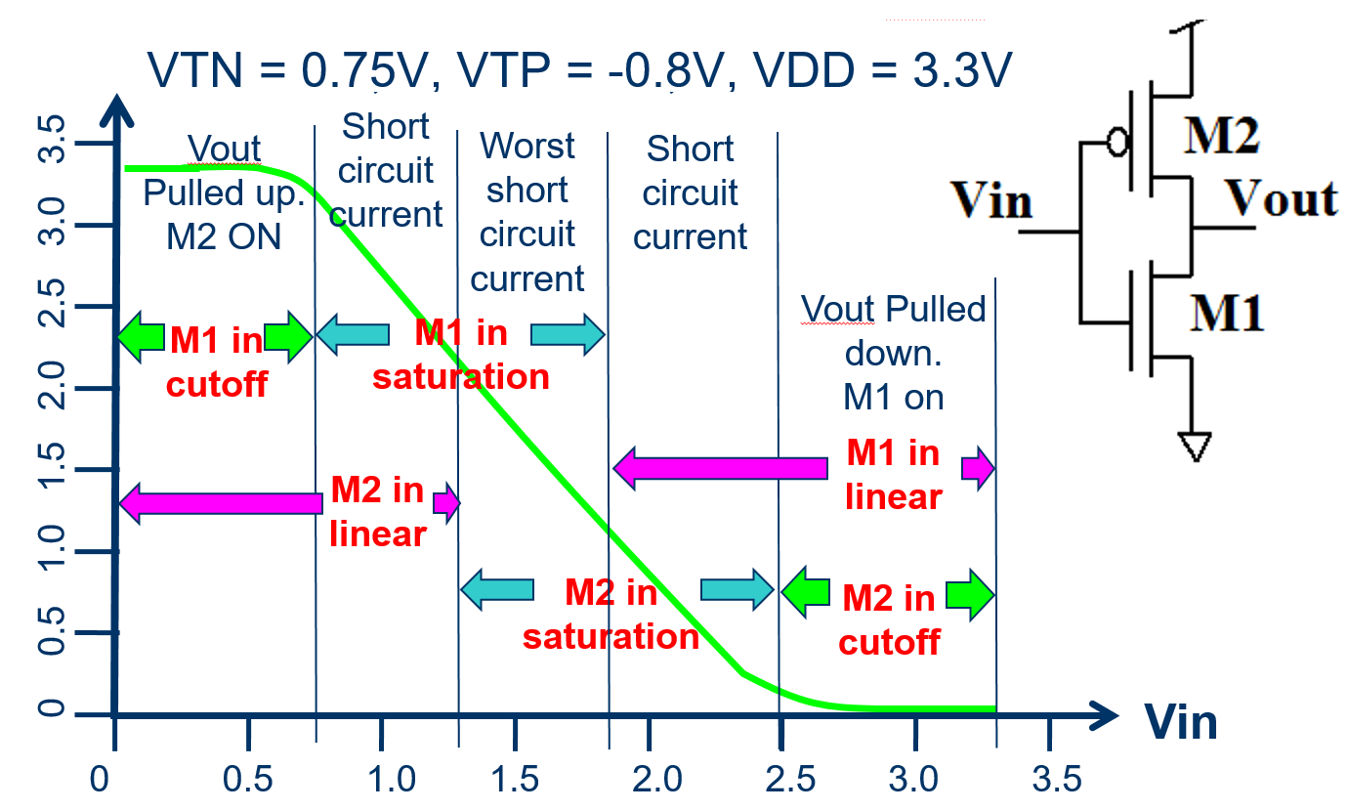
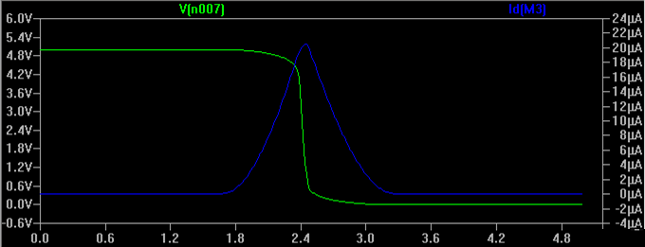
Looks bad but it’s not as bad as it looks
0.0 0.5 1.0 1.5 2.0 2.5 3.0 3.5

Slide 31
Shape of graph using load lines

Slide 32
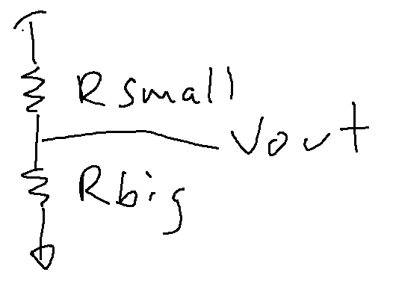
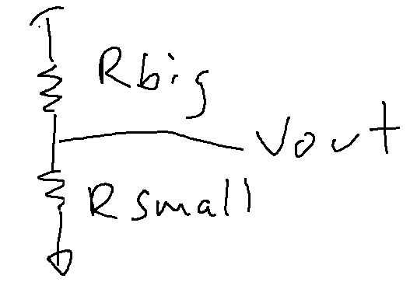
Looking at inverter as voltage divider
If Vin is small, M1 won’t be
conducting much.
If Vin is small, M2 will be
conducting a lot.
That equates to:
Vout is large or small?
What about if Vin is large?
Vout is large or small?

Slide 33
Analysis technique: Load line
Divide circuit into two parts and come up with voltages and currents that make them both happy.
DC solution
Let’s do a voltage divider:

Slide 34
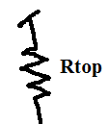

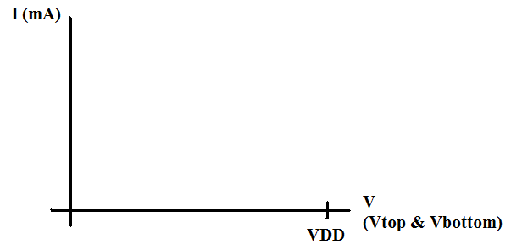
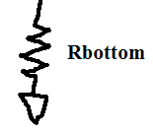
Steps for load line analysis Example 1
Cut it in half
Graph each half separately
Find where both are satisfied
VDD/Rtop
VDD/Rbottom

Slide 35
Steps for load line analysis Example 1
Cut it in half
Graph each half separately
Find where both are satisfied
Itop
Only place where Itop equals Ibottom
VDD/Rtop
Ibottom
VDD/Rbottom
Operating point
I
Vout

Slide 36
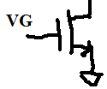
New logic family
RTL: Resistor-transistor logic family
Pull up network is a resistor
Old logic family
Voutmax? VDD
Voutmin? VDD - [ IDS(VGS=VDD) x R_{top}]
Which NM suffers? (Vin) NML
What else is wrong with this logic family?
Power → When Vout is low, current will be flowing continuously
Resistors are large

Slide 37
Steps for load line analysis Example 2
Cut it in half
Graph each half separately
Find where both are satisfied
Only place where Itop equals Ibottom
VDD/Rtop
Operating point

Slide 38
Steps for load line analysis Example 2
Cut it in half
Graph each half separately
Find where both are satisfied
Itop
Only place where Itop equals Ibottom
VDD/Rtop
Ibottom
Operating point
I
Vout

Slide 39
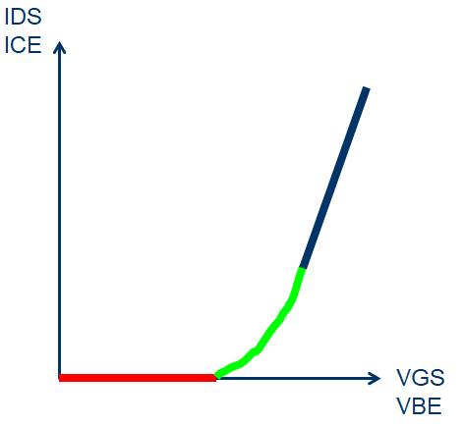
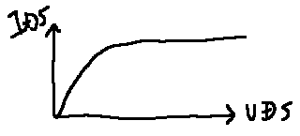
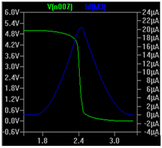
Inverter – More detail
NMOS
Cutoff (VGS < VTN)
Linear, Ohmic, resistive
(VGS > VTN, VDS < VGS-VT)
Active, saturation, pinch-off
(VGS > VTN, VDS > VGS-VT)
NOTE: IDS > 0
VGS > 0
VT > 0
VDS > 0
k_{n}’ > 0
Case 1: Vin=3.3V
Case 2: Vin=GND
Case 3: Vin=VTN
Case 4: Vin=VDD-|VTP|
Case 5: Vin=Vsup/2
Notes:
Shichman–Hodges model – that’s what this equation is called

Slide 40
Looks bad but it’s not as bad as it looks
Short circuit current looks bad… But if you are only in the middle region for a short period of time, it doesn’t hurt too much.
If λ is small and IDS changes, the circuit will quickly switch Vout from high to low or low to high.
Explain this to your neighbor

Slide 41
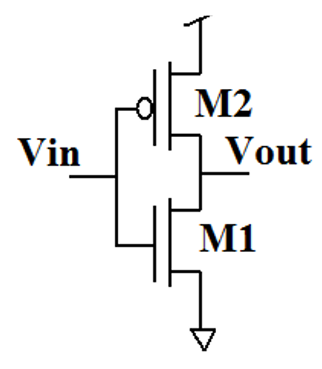
Finding points on graph w/ math (1/8)
Vin < VTN
M1 is in cutoff.
The same current must be going through both M1 and M2.
So M2 has to be conducting 0A.
But its VGS=VDD so M2 on.
Region of operation? Linear
VGS is constant and VDS is
changing so what graph is
appropriate?
And where is the PMOS operating?

Slide 42
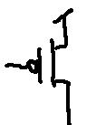
Need to figure out right Vout for equal current through M1 and M2
Cut it in half
Graph each half separately
Find where both are satisfied
VG
Only place where Itop equals Ibottom
I
Operating point
Vout

Slide 43
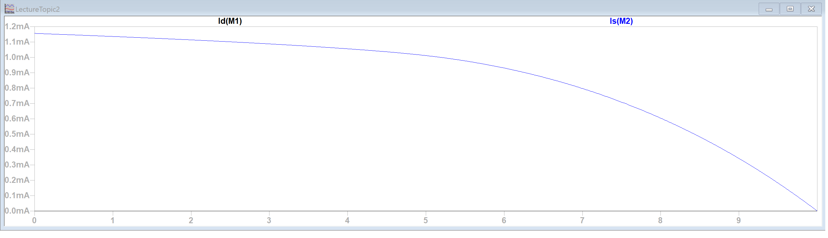
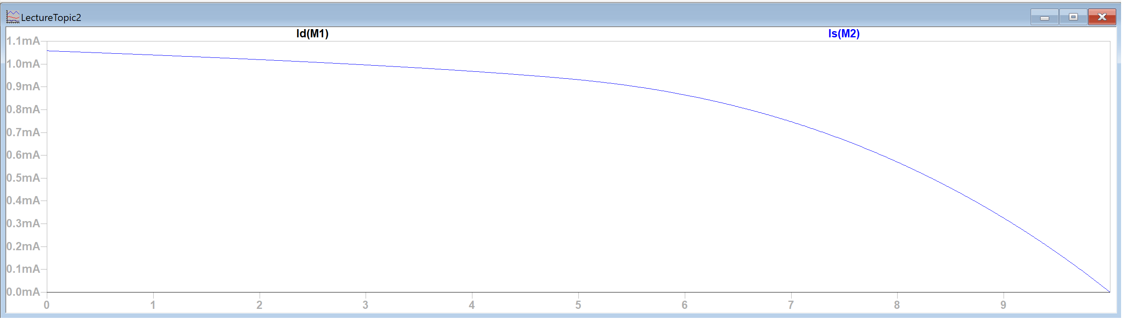
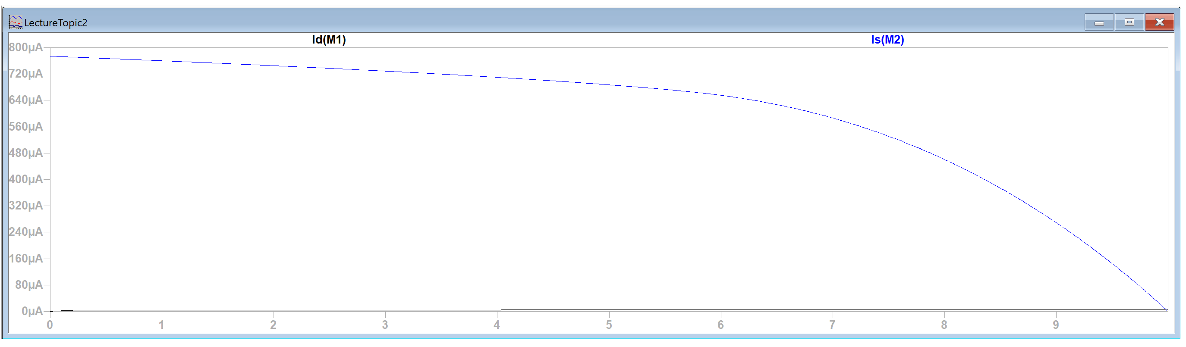
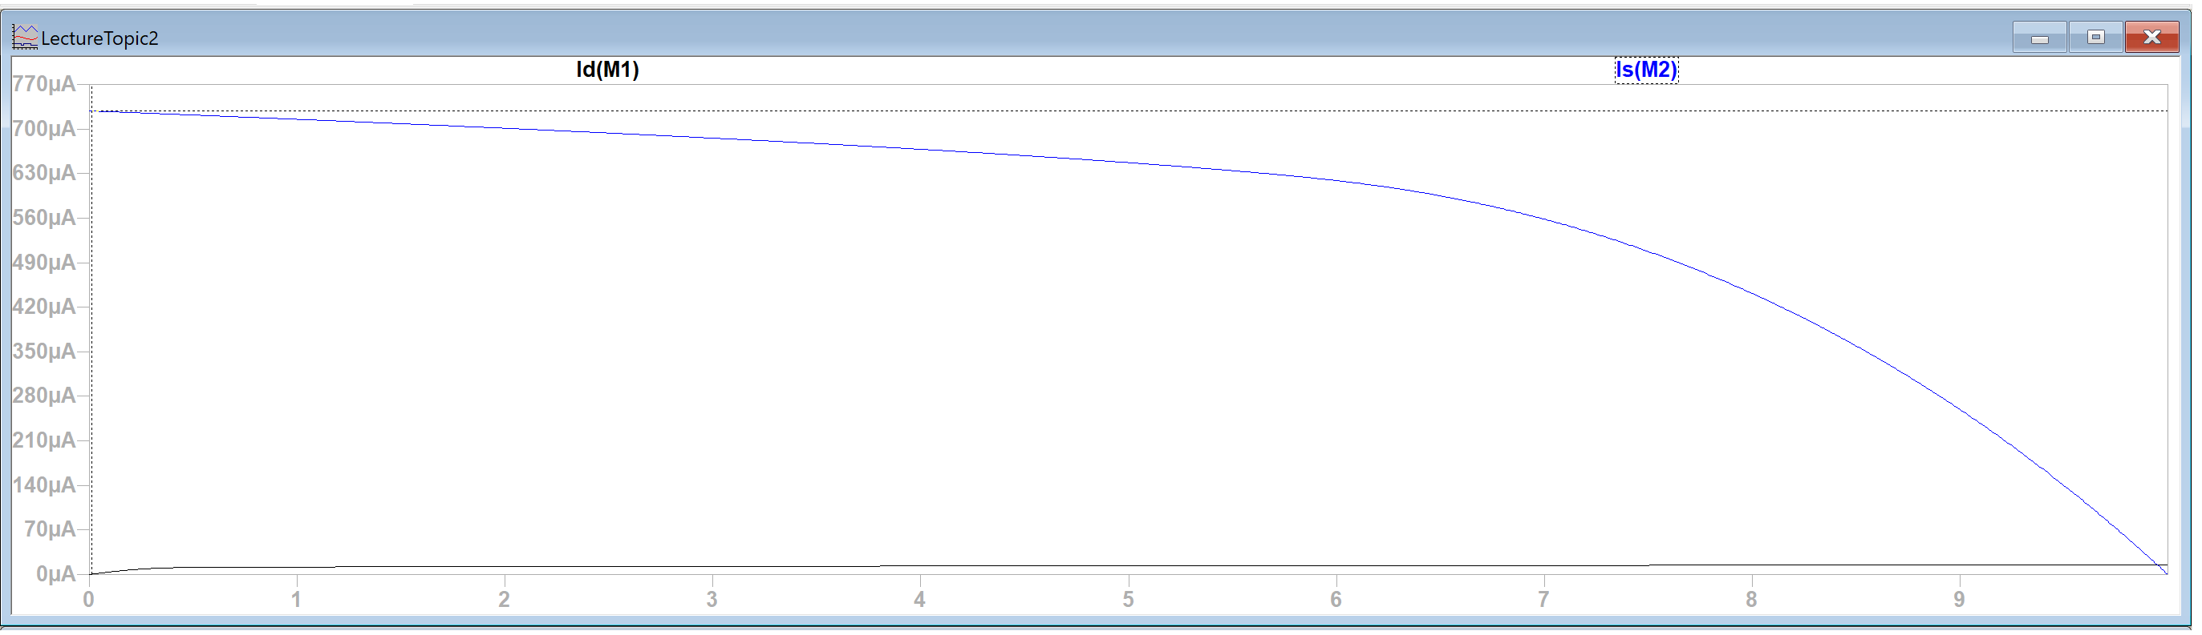
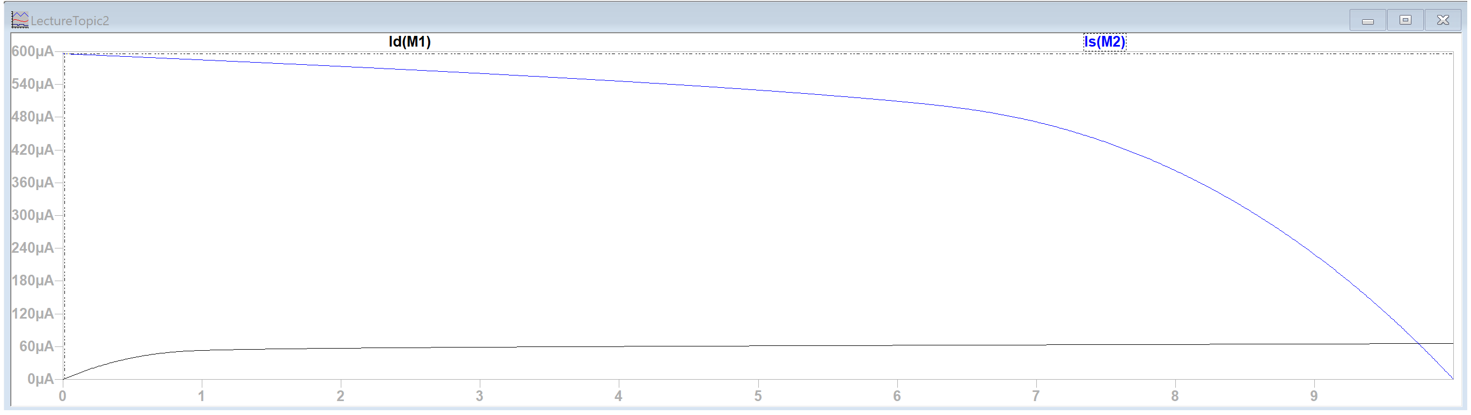
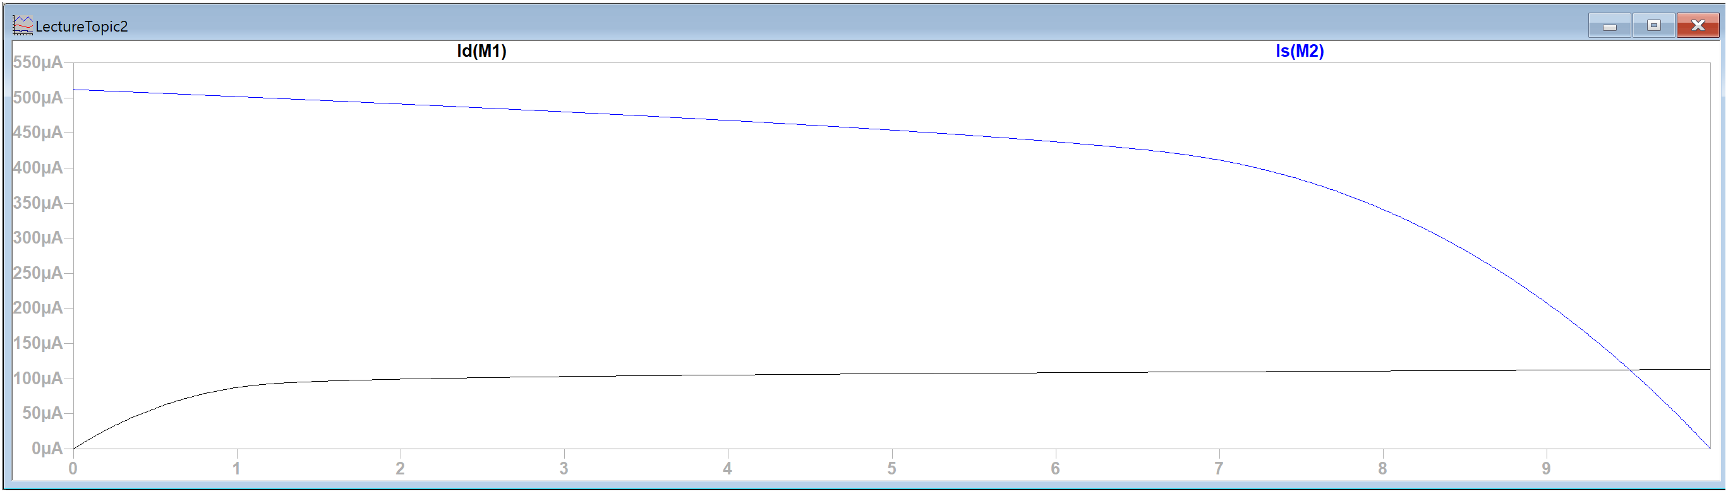
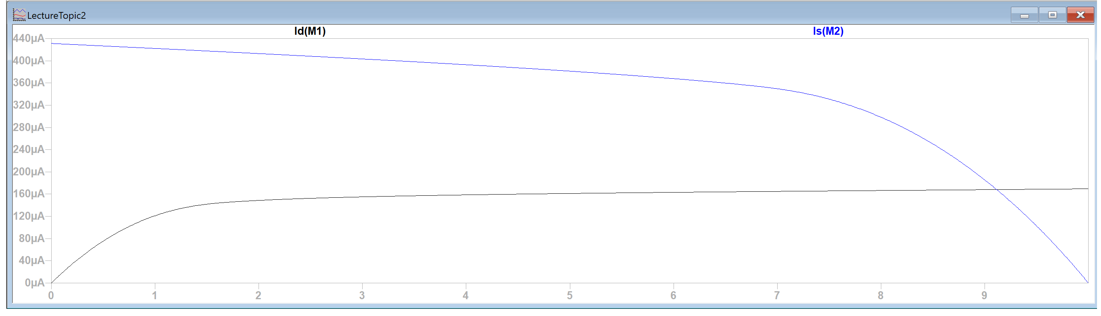
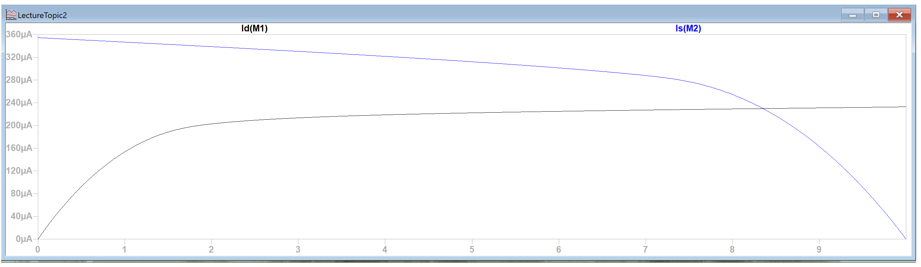
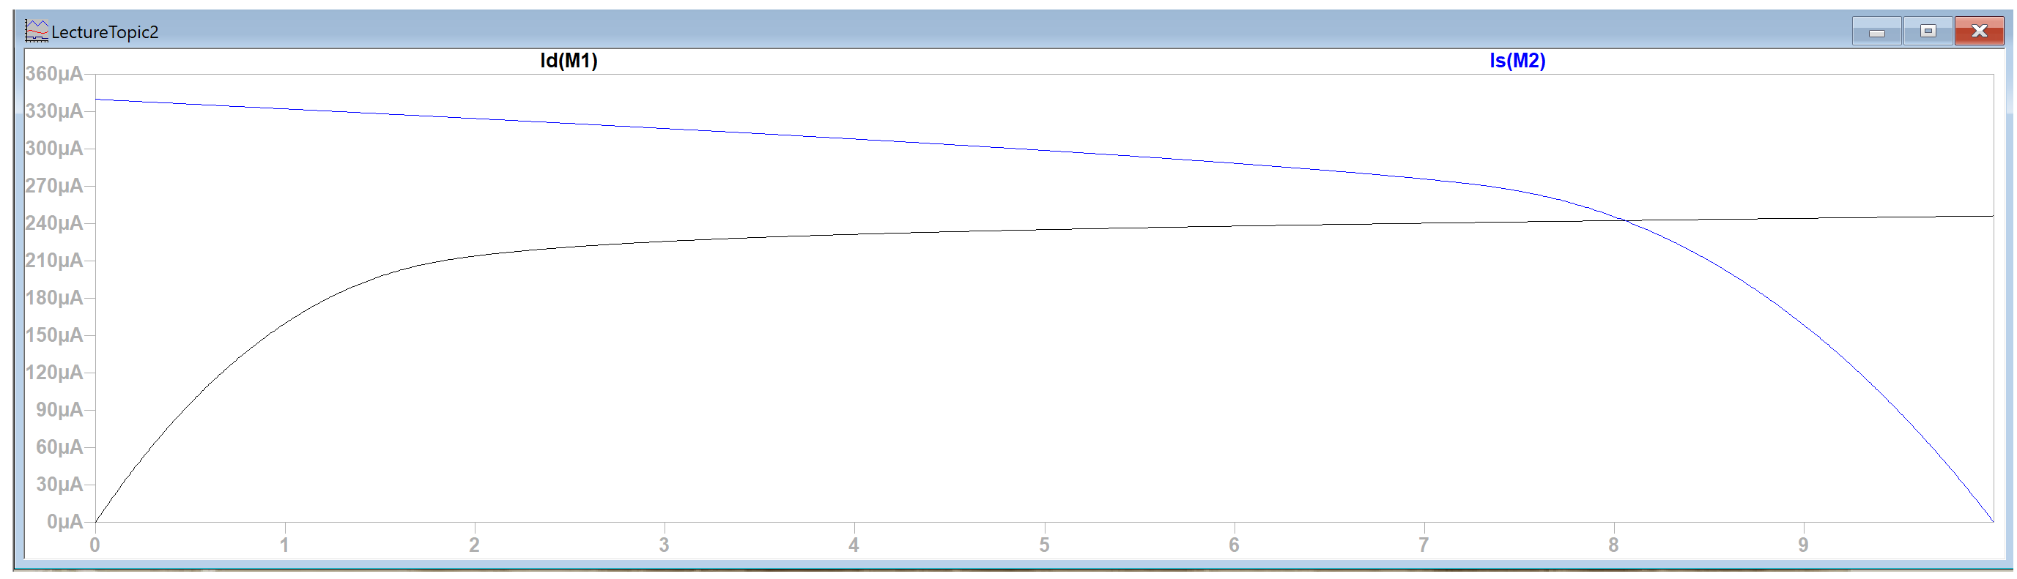
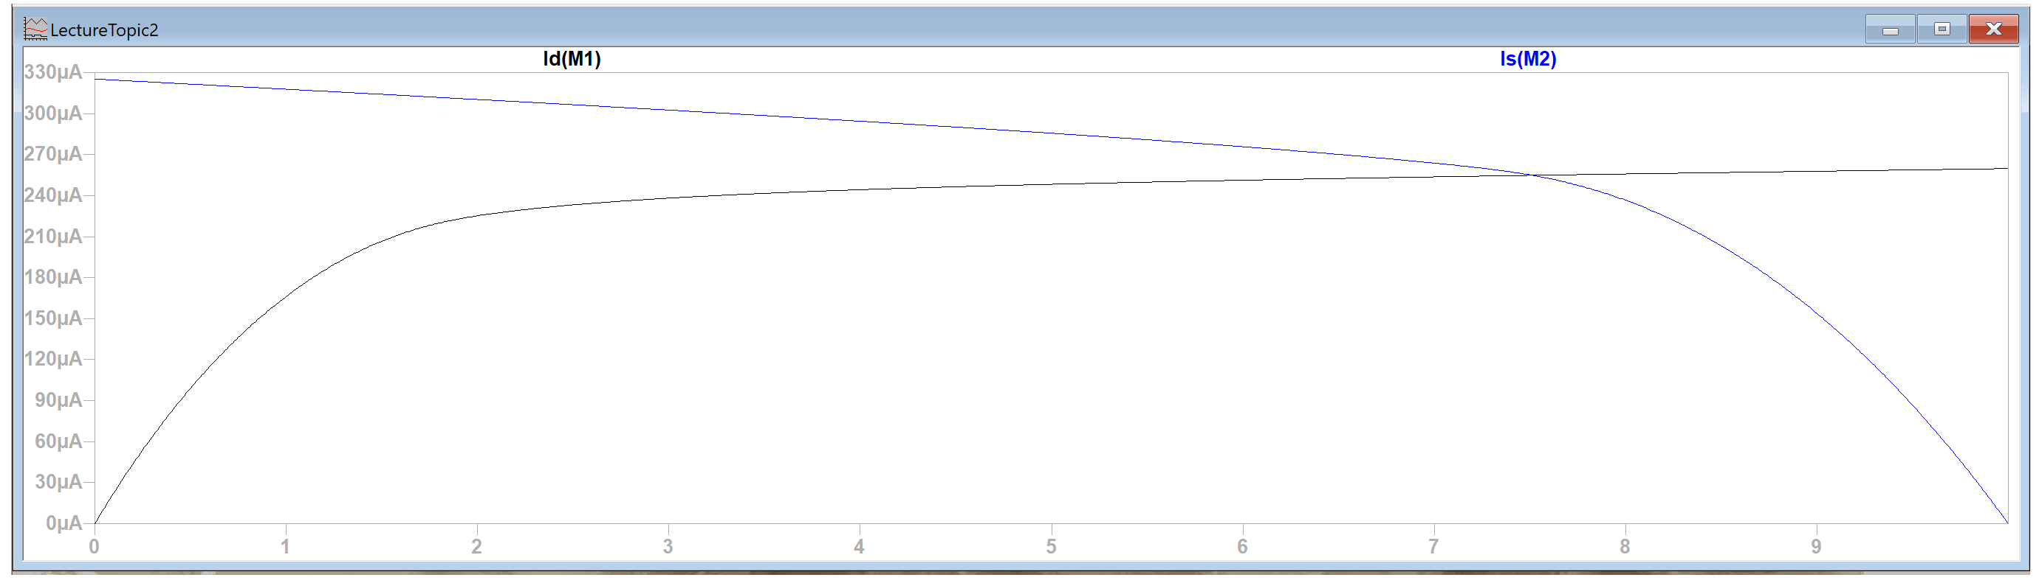
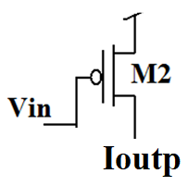
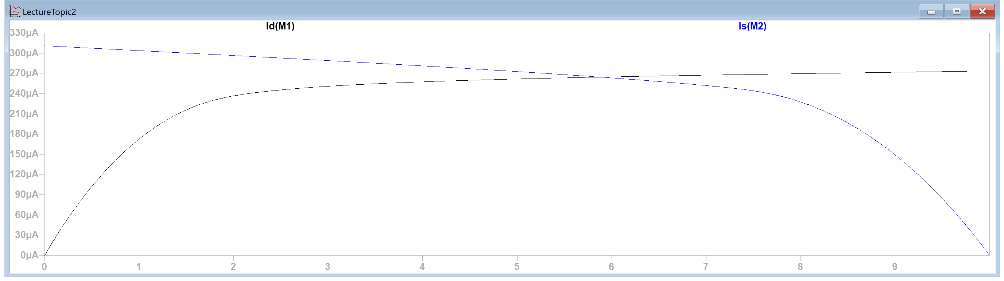
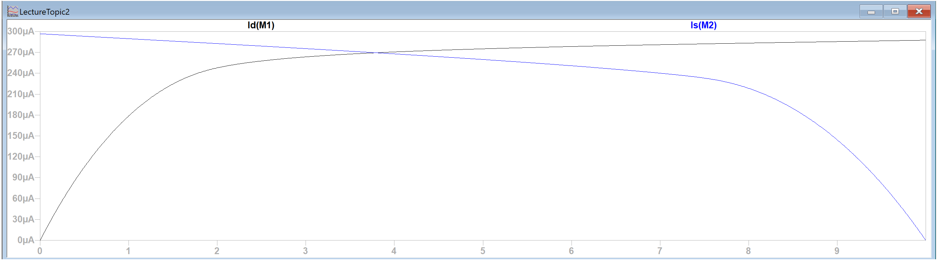
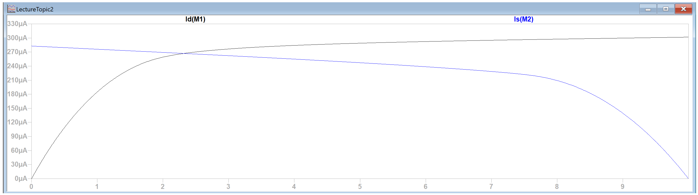
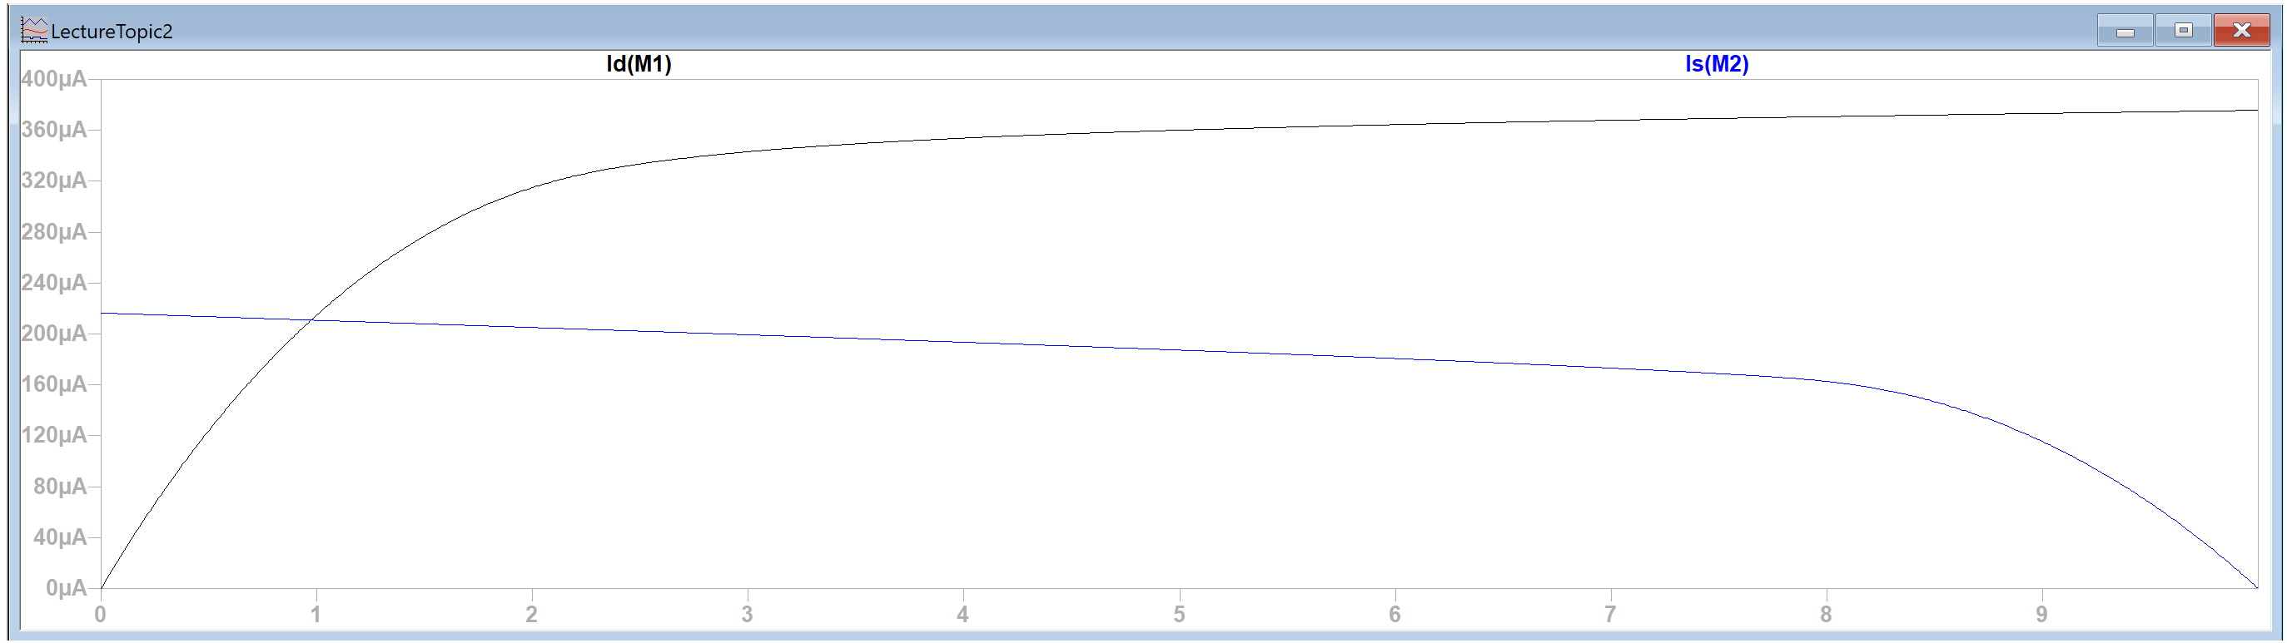
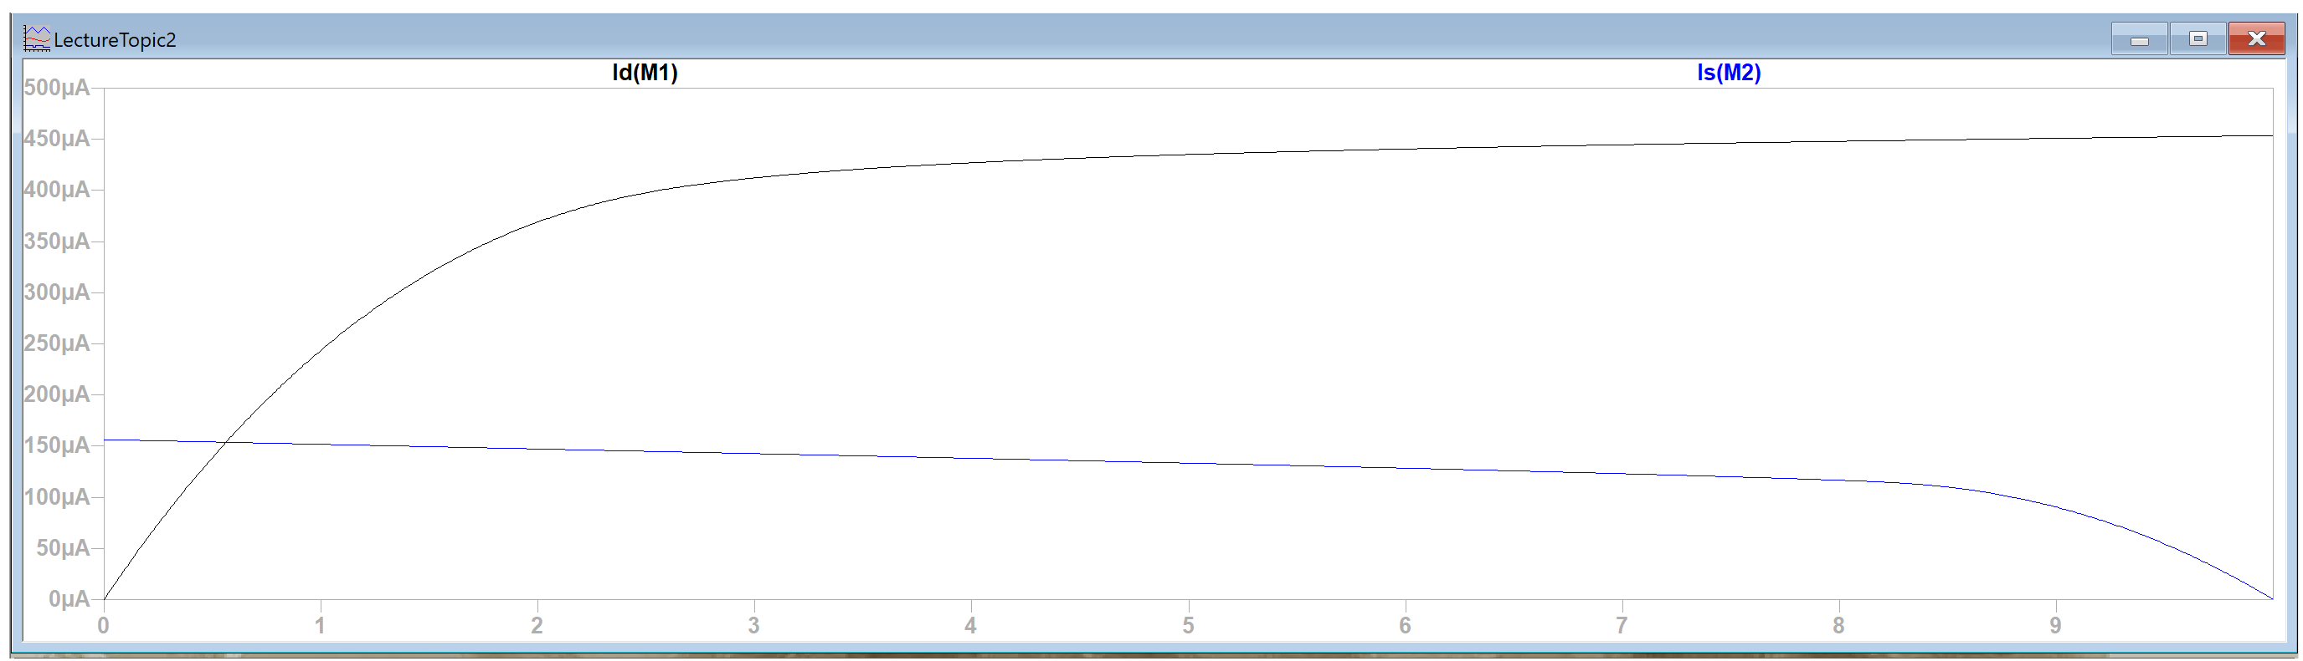
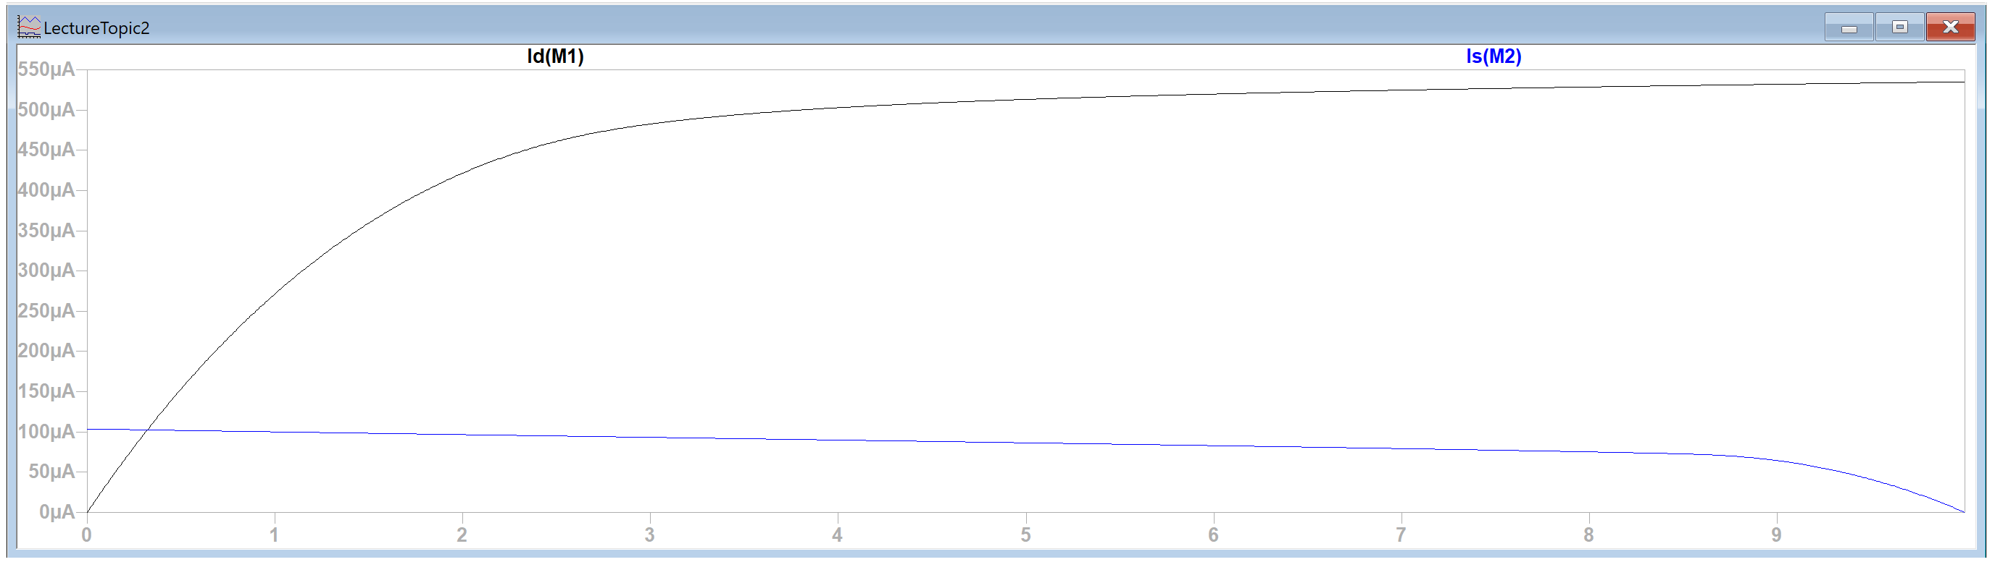
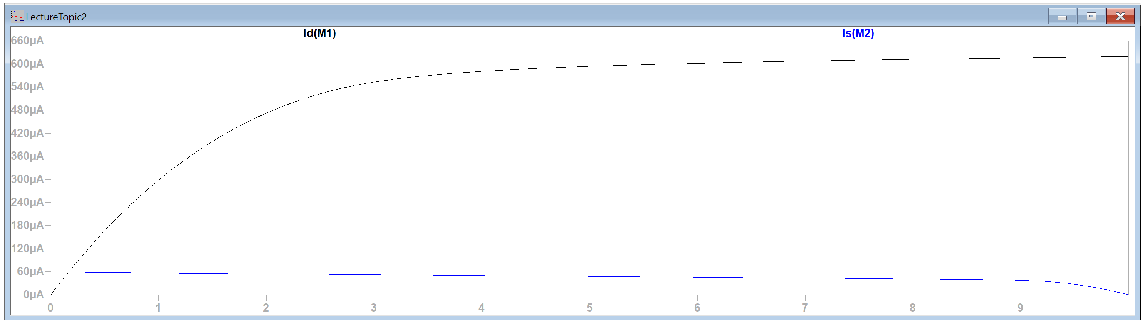
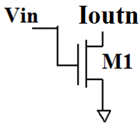
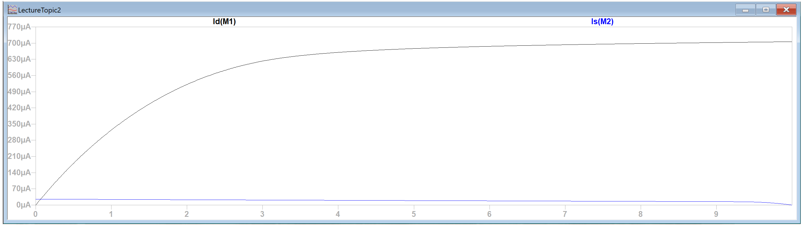
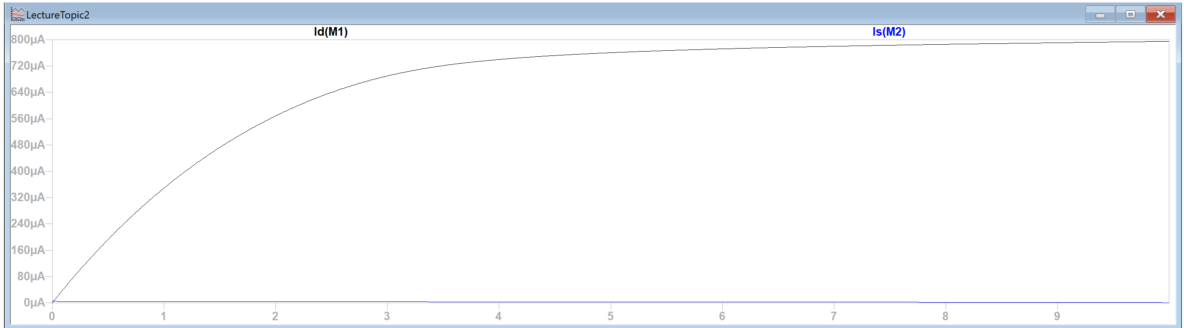
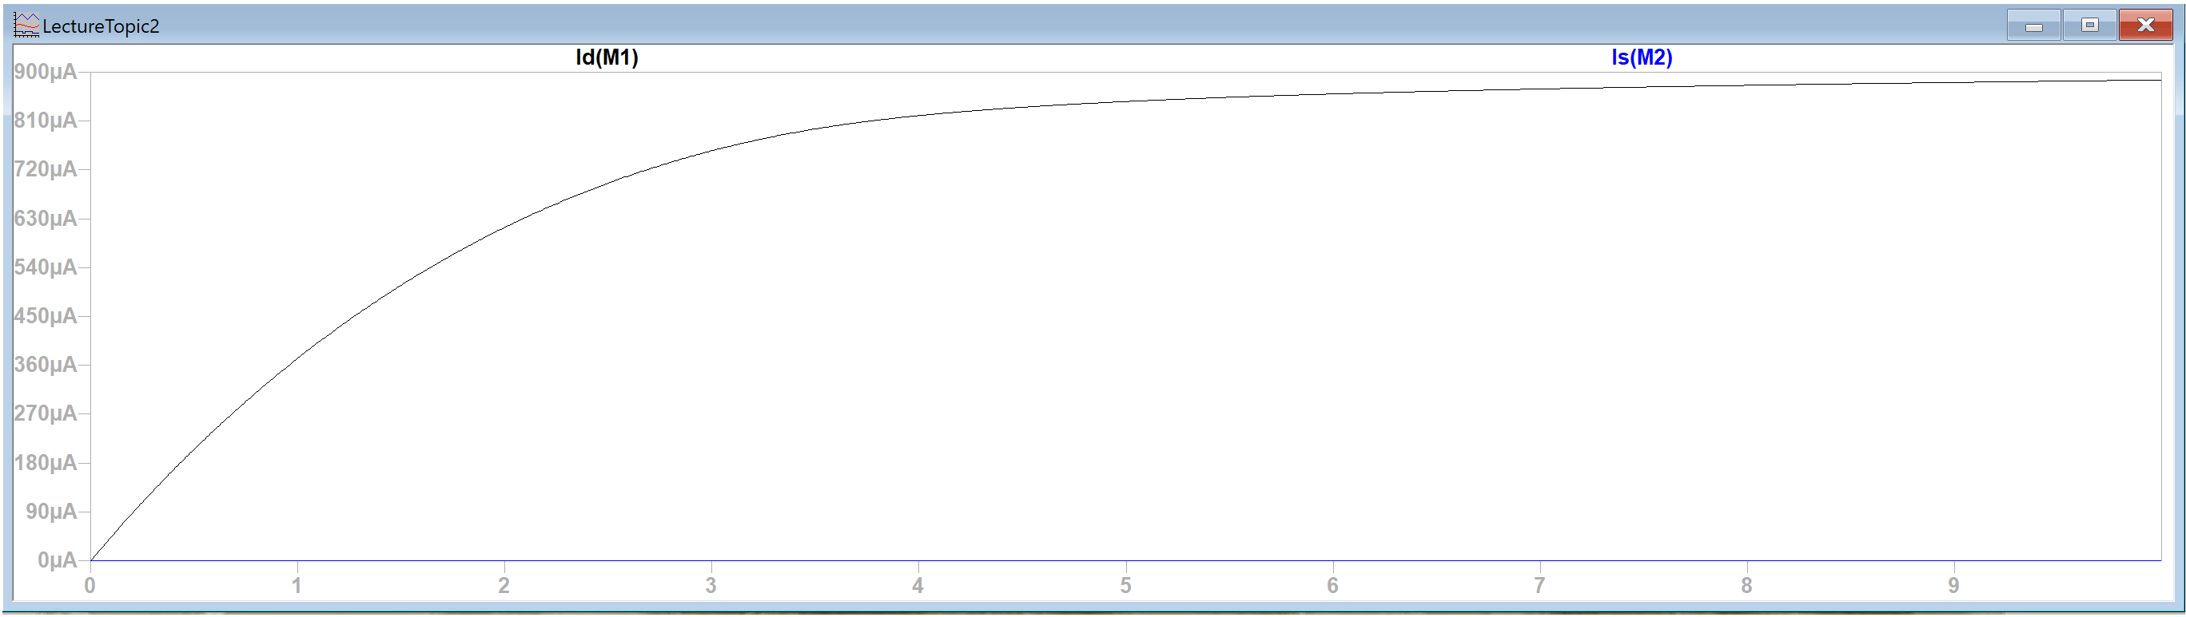
VTC
Vin=0V, Vout=10V
Vin=1.5V, Vout=10V
Vin=2V, Vout=9.98V
Vin=2.5V, Vout=9.78V
Vin=3V, Vout=9.748V
Vin=3.5V, Vout=9.51V
Vin=4V, Vout=9.12V
Vin=4.5V, Vout=8.35V
Vin=4.6V, Vout=8.05V
Vin=4.7V, Vout=7.51V
Vin=4.8V, Vout=5.88V
Vin=4.9V, Vout=3.79V
Vin=5V, Vout=2.32V
Vin=5.5V, Vout=0.97V
Vin=6V, Vout=0.56V
Vin=6.5V, Vout=0.32V
Vin=7V, Vout=0.10V
Vin=7.5V, Vout=0.06V
Vin=8V, Vout=0.01V
Vin=8.5V, Vout=0V
Vin=10V, Vout=0V

Slide 44
Graphing….
Vin=0V, Vout=10V
Vin=1.5V, Vout=10V
Vin=2V, Vout=9.98V
Vin=2.5V, Vout=9.78V
Vin=3V, Vout=9.748V
Vin=3.5V, Vout=9.51V
Vin=4V, Vout=9.12V
Vin=4.5V, Vout=8.35V
Vin=4.6V, Vout=8.05V
Vin=4.7V, Vout=7.51V
Vin=4.8V, Vout=5.88V
Vin=4.9V, Vout=3.79V
Vin=5V, Vout=2.32V
Vin=5.5V, Vout=0.97V
Vin=6V, Vout=0.56V
Vin=6.5V, Vout=0.32V
Vin=7V, Vout=0.10V
Vin=7.5V, Vout=0.06V
Vin=8V, Vout=0.01V
Vin=8.5V, Vout=0V
Vin=9V, Vout=0V
Vin=10V, Vout=0V
Vout
0 1 2 3 4 5 6 7 8 9 10
0 1 2 3 4 5 6 7 8 9 10
Vin

Slide 45
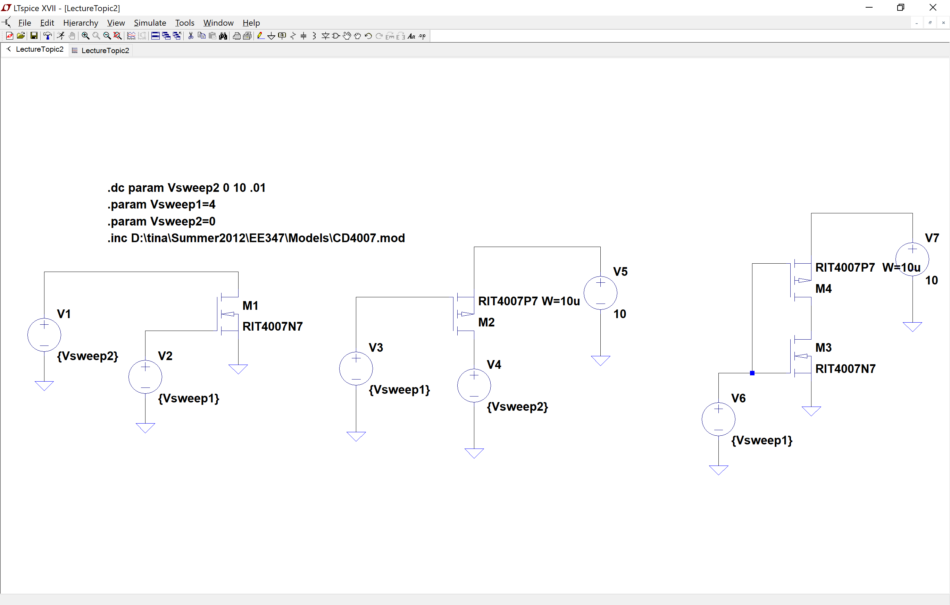
Circuits used

Slide 46
Just a reminder….
The VTC is for finding the DC characteristics and those include VIL, VIH, VOL, VOH, Vm, NMH and NML
Next we’ll look at the time dependent stuff: Delays (=speed of your circuit)
We’ll stick with inverters for the rest of this topic but, in the next topic, we’ll look at how you’d find the delay for a complex CMOS gate.

Slide 47
Language of digital circuits
Terms used to describe performance (static=DC)
Vm : Vin=Vout
Vmax, Vmin , VOH, VOL, VIH, VIL, NM_{H}, NM_{L}
Vm

Slide 48
Vm: Currents equal and in the active region

Slide 49
Vm we’ll use
I’ll expect you to know how to find Vm but…
We’ll use: Vm = (Vomax – Vomin)/2

Slide 50
NOTE: Definition of NM_{H}, NM_{L} vary
Different books and websites define NM_{H} and NM_{L} differently.
Gopalan uses different definition.

Slide 51
Techniques to find VIL, VIH, VOL & VOH (m = -1 slope points)
Understanding what they mean is most important BUT, if you did want to do the math…..
Techniques
Reading it off a graph
Find slope at Vm and extrapolate
Load line knowing that the same current goes through top and bottom and then do implicit differentiation

Slide 52
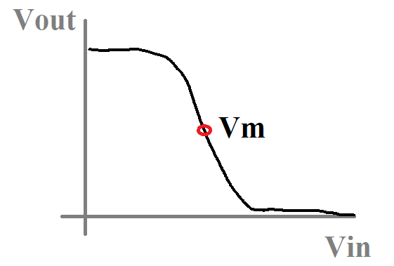
Find slope at Vm and extrapolate
Slope @ Vm = -g
Vm @ Vin=Vout=VDD/2
or, more correctly:
Vm = (Vomax-Vomin)/2
Y=mx+b ➔ Vout(Vin) = -g·Vin+b
To find “b”, set Vin=Vout=Vm:
Vm = -g·Vm + b ➔ b = Vm(1+g)
To find Vins:
Vout = -g·Vin + Vm(1+g)
Vomax = -g·Vin1 + Vm(1+g)
Vomin = -g·Vin2 + Vm(1+g)
m = -1
Vomax
Vomin
m = -1

Slide 53
Finding “g”
EE308 topic
Where IDS is the current at Vin(VGS)=Vm
I’ll show you math if you’d like. Take EE308 to see where this came from.

Slide 54
Implicit Differentiation (1/)
Tough to separate Y from X
Need to use “Implicit Differentiation”
Treat Y as a function of X
Product Rule:
Power Chain Rule:

Slide 55
Implicit Differentiation (1/)
Look at single term:
Derivative with respect to X:
Doing the entire equation you get:

Slide 56
Implicit Differentiation (1/)
Look at single term:
Derivative with respect to X:
Doing the entire equation you get:

Slide 57
Implicit Differentiation to find -1 slope point (Slope=dY/dX=dVout/dVin=dVDS/dVGS) →VOH, VIL
Taking the derivative with respect to VGS:
Still have both VDS and VGS in equation

Slide 58
Final word on VIL, VIH, VOL and VOH
Know how to use the slope to get Vin for VIH and VOH (method 2)
Also know how to read off the graph (method 1 and what you would use in experimental situations)
Method 3 is for reference

Slide 59
Slope = Gain (Digital/EE307)
The operating region for EE307 and EE308
Vout
Not as clear whether it’s a ‘1’ or a ‘0’
Clearly high! No doubt it’s a logic ‘1’
Clearly low! No doubt it’s a logic ‘0’
0 0.5 1.0 1.5 2.0 2.5 3.0 3.5
Bad digital region
Good digital region
Good digital region
Vout Pulled down.
M1 on
Vout Pulled up.
M2 on
Short circuit current
Vin
0 0.5 1.0 1.5 2.0 2.5 3.0 3.5

Slide 60
Slope = Gain (Analog/EE308)
The operating region for EE307 and EE308
Vout
Change Vin: Vout does change
Change Vin: Vout doesn’t change
Change Vin: Vout doesn’t change
0 0.5 1.0 1.5 2.0 2.5 3.0 3.5
Good analog region
Bad analog region
Bad analog region
Vout Pulled down.
M1 on
Vout Pulled up.
M2 on
Short circuit current
Vin
0 0.5 1.0 1.5 2.0 2.5 3.0 3.5

Slide 61
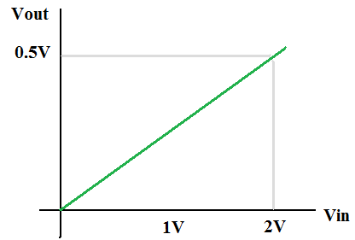


Slope < 1: How much does Vout change?
VTC
What’s the slope?: 0.5V/2V=1/4
Transient Response

Slide 62

Slope < 1: How much does Vout change?
VTC
What’s the VTC slope?: 0.5V/2V=1/4
What’s the input slope?:
What’s the output slope?:
Transient Response

Slide 63
Slope < 1: How much does Vout change?
6V
VTC
6V
3V
What’s the VTC slope?: 6V/2V=3
What’s the input slope?:
What’s the output slope?:
Transient Response

Slide 64





Simpler version
INPUT (m=1/2)
VTC (m=1/4)
OUTPUT (m=1/8)
➔
➔
OUTPUT (m=3/4)
INPUT (m=1/2)
VTC (m=1.5)
➔
➔

Slide 65


Even simpler version
m=X
m=X/2
m=X
m=2∙X

Slide 66
Another way to divide up graph
Before: Divided up graph by transistor region of operation
Now: Divide up graph by regenerative and non-regenerative regions
Vout
Slope = -1
|Slope| > 1
Slope < -1
0 0.5 1.0 1.5 2.0 2.5 3.0 3.5
|Slope| < 1
Slope = -1
Vin
0 0.5 1.0 1.5 2.0 2.5 3.0 3.5

Slide 67
Regenerative circuit
If the slope of (most of) the transition region has a |slope| > 1 then the circuit is called regenerative.
If the slope of (most of) the transition region has a |slope| < 1 then the circuit is called non-regenerative.

Slide 68


Regeneration – Regenerative circuits
With good transitions, the circuit will only be in the short circuit region for a short time.

Slide 69
Dynamic metrics: Delay

Slide 70

Language of digital circuits (2)
Terms used to describe performance (dynamic)
t_{PHL}, t_{PLH}
t_{R}, t_{F}
New terms
Fan-in = # of inputs
Fan-out = # of circuits being driven by output of circuit

Slide 71
Delay is how long it takes to charge capacitance through transistor
The capacitance is the capacitance from the transistors and the wires
The capacitances get charged up (and discharges) by current through a transistor
Transistor is like an “R”
C is “C”
R-like behavior from transistors not giving infinite current
V_{OUT}
R
C from transistors and wires
+
--
V_{in}

Slide 72
What we’ll look at
How to find “R”
Not a real resistor
Current through transistor, voltage across transistor
Not quite that simple….
How to find “C”
Sum of capacitances on transistor
Plus sum of capacitances on wire

Slide 73
Delay equation = RC
The capacitance is the capacitance from the transistors and the wires
The capacitances get charged up (and discharges) by current through a transistor
Transistor is like an “R”
C is “C”
V_{OUT}
R
+
--
V_{in}

Slide 74
Delay equation = RC
V_{OUT}
R
+
--
V_{in}
RC time constant

Slide 75
Delay calculation: tp Low to high
Assume: Vmax=VDD, Vm=VDD/2 and that Vin switches instantaneously.

Slide 76
Delay calculation: tp High to low
Assume: Vmax=VDD, Vm=VDD/2 and that Vin switches instantaneously.

Slide 77
Moral of the story
R of a node times C of a node times 0.69 = tp
Next: How to find R and C

Slide 78
Resistance

Slide 79

R for tpHL calculation
Not actual resistor → Perceived resistance:
Voltage across transistor
Current through transistor

Slide 80

Calculate R: (Technique 1)
Take average over range by integration

Slide 81
Calculate R: (Technique 2)
Take average of ends of range

Slide 82
Calculate R: (Technique 3)
Randomly pick a point near the middle of the region:

Slide 83
Transient Response
?
t_{pHL} = 0.69 C_{L} R_{eqn}
t_{pLH} = 0.69 C_{L} R_{eqp}
t_{p} = 0.69 C_{L} (R_{eqn}+R_{eqp})/2
t_{pLH}
t_{pHL}

Slide 84

Calculating R and C of wires

Slide 85
Wire R calculation
Equation:
L=Length of wire
W=Width of wire
Example: N+ L=10μm, W=1μm

Slide 86

Wire C calculation
➔ C = Area x C per unit area
C per unit area:
Example: C between M1 and M2=116aF/µm²
So 1µm x 1µm area would have 116aF of C

Slide 87

S & D Resistance
Generally
20-100
Silicidation
Coat S and D with titanium or tungsten
1-4
R_{S}
R_{D}

Slide 88
Capacitance of transistors

Slide 89
Example: Intel early chip

Slide 90

Capacitance
Channel (Gate)
Capacitance
Physical
(Overlap)
Capacitance
CGS_{OV}
CGD_{OV}
Physical
(Overlap)
Capacitance
CSB
CGC
(Different for different regions of operation)
CDB
Diffusion
Capacitance
Diffusion
Capacitance
Notes:
Remember to explain field effect

Slide 91
Three sources of capacitance in MOSFETs
Basic MOS structure
Two conductors separated by insulator
Channel charge
Channel (either charge or substrate) forms second plate
Depletion region
PN junctions

Slide 92
Basic MOS Structure Capacitance C_{GS} = C_{GS0}W, C_{GD} = C_{GD0}W
Polysilicon gate
Source
Drain
W
Always Exists
(Included in gate capacitance)
n
+
x
d
x
d
n
+
L
Gate-bulk
d
overlap
Top view
Gate oxide
t
ox
n
+
L
n
+
Cross section

Slide 93

Channel Capacitance C_{GB}, C_{GS}, C_{GD} =Gate
C to charge but that’s only 2/3 of channel
C to substrate
C to charge
Cutoff
Linear
Active
Cut-off
Resistive
Saturation
Plus overlap capacitance

Slide 94

Depletion Region Capacitance “Diffusion” Capacitance
Channel-stop implant
C_{SW}
N
A
1
Side wall
W
Source
N
D
C_{SW}
Bottom
x
j
Side wall
C_{SW}
Channel
L
C_{Bottom}
S
Substrate
N
A
Bulk
C_{diff}
= C_{Bottom}
+ C_{SW}
= C_{j} x Area + C_{jsw} x PERIMETER

Slide 95
(Single) MOSFET capacitance calculation
Region of operation: Gate C differs
Find where we’re sitting: You’ll be looking from the gate, drain or source. Figure out which one.
We’ll do all three… Looking into the gate first.

Slide 96
(Single) MOSFET gate capacitance
Three components:
Channel capacitance:
Basic MOS structure:
Depletion regions:

Slide 97
SPICE NMOS Model
.MODEL N1 NMOS LEVEL = 14
+VERSION = 4.6.0 BINUNIT = 1 PARAMCHK= 1 MOBMOD = 0
+CAPMOD = 2 IGCMOD = 1 IGBMOD = 1 GEOMOD = 1
+DIOMOD = 1 RDSMOD = 0 RBODYMOD= 0 RGATEMOD= 1
+PERMOD = 1 ACNQSMOD= 0 TRNQSMOD= 0 TEMPMOD = 0
+TNOM = 27 TOXE = 1.8E-009 TOXP = 10E-010 TOXM = 1.8E-009
+DTOX = 8E-10 EPSROX = 3.9 WINT = 5E-009 LINT = 1E-009
+LL = 0 WL = 0 LLN = 1 WLN = 1 +LW = 0 WW = 0 LWN = 1 WWN = 1
+LWL = 0 WWL = 0 XPART = 0 TOXREF = 1.4E-009
+SAREF = 5E-6 SBREF = 5E-6 WLOD = 2E-6 KU0 = -4E-6
+KVSAT = 0.2 KVTH0 = -2E-8 TKU0 = 0.0 LLODKU0 = 1.1
+WLODKU0 = 1.1 LLODVTH = 1.0 WLODVTH = 1.0 LKU0 = 1E-6
+WKU0 = 1E-6 PKU0 = 0.0 LKVTH0 = 1.1E-6 WKVTH0 = 1.1E-6
+PKVTH0 = 0.0 STK2 = 0.0 LODK2 = 1.0 STETA0 = 0.0 +LODETA0 = 1.0
+LAMBDA = 4E-10 VSAT = 1.1E+005 +VTL = 2.0E5 XN = 6.0 LC = 5E-9
+RNOIA = 0.577 RNOIB = 0.37 +LINTNOI = 1E-009
+TVOFF = 0.0 TVFBSDOFF = 0.0
+VTH0 = 0.25 +K1 = 0.35 K2 = 0.05 K3 = 0
+K3B = 0 W0 = 2.5E-006 DVT0 = 1.8 DVT1 = 0.52
+DVT2 = -0.032 DVT0W = 0 DVT1W = 0 DVT2W = 0
+DSUB = 2 MINV = 0.05 VOFFL = 0 DVTP0 = 1E-007
+DVTP1 = 0.05 LPE0 = 5.75E-008 LPEB = 2.3E-010 XJ = 2E-008
+NGATE = 5E+020 NDEP = 2.8E+018 NSD = 1E+020 PHIN = 0
+CDSC = 0.0002 CDSCB = 0 CDSCD = 0 CIT = 0
+VOFF = -0.15 NFACTOR = 1.2 ETA0 = 0.05 ETAB = 0
+UC = -3E-011 +VFB = -0.55 U0 = 0.032 UA = 5.0E-011 UB = 3.5E-018
+A0 = 2 AGS = 1E-020 +A1 = 0 A2 = 1 B0 = -1E-020 B1 = 0
+KETA = 0.04 DWG = 0 DWB = 0 PCLM = 0.08
+PDIBLC1 = 0.028 PDIBLC2 = 0.022 PDIBLCB = -0.005 DROUT = 0.45
+PVAG = 1E-020 DELTA = 0.01 PSCBE1 = 8.14E+008 PSCBE2 = 5E-008
+FPROUT = 0.2 PDITS = 0.2 PDITSD = 0.23 PDITSL = 2.3E+006
+RSH = 0 RDSW = 50 RSW = 50 RDW = 50
+RDSWMIN = 0 RDWMIN = 0 RSWMIN = 0 PRWG = 0
+PRWB = 6.8E-011 WR = 1 ALPHA0 = 0.074 ALPHA1 = 0.005
+BETA0 = 30 AGIDL = 0.0001 BGIDL = 2.1E+009 CGIDL =
+EGIDL = 0.8 AGISL = 0.0002 BGISL = 2.1E+009 CGISL = 0.0002
+EGISL = 0.8 +AIGBACC = 0.012 BIGBACC = 0.0028 CIGBACC = 0.002
+NIGBACC = 1 AIGBINV = 0.014 BIGBINV = 0.004 CIGBINV = 0.004
+EIGBINV = 1.1 NIGBINV = 3 AIGC = 0.012 BIGC = 0.0028
+CIGC = 0.002 AIGS = 0.012 BIGS = 0.0028 CIGS = 0.002
+NIGC = 1 POXEDGE = 1 PIGCD = 1 NTOX = 1
+AIGD = 0.01 BIGD = 0.003 CIGD = 0.0015 +XRCRG1 = 12 XRCRG2 = 5
+CGSO = 6.238E-010 CGDO = 6.238E-010 CGBO = 2.56E-011 CGDL = 2.495E-10
+CGSL = 2.495E-10 CKAPPAS = 0.03 CKAPPAD = 0.03 ACDE = 1
+MOIN = 15 NOFF = 0.9 VOFFCV = 0.02
+KT1 = -0.37 KT1L = 0.0 KT2 = -0.042 UTE = -1.5
+UA1 = 1E-009 UB1 = -3.5E-019 UC1 = 0 PRT = 0 +AT = 53000
+FNOIMOD = 1 TNOIMOD = 0
+JSS = 0.0001 JSWS = 1E-011 JSWGS = 1E-010 NJS = 1
+IJTHSFWD= 0.01 IJTHSREV= 0.001 BVS = 10 XJBVS = 1
+JSD = 0.0001 JSWD = 1E-011 JSWGD = 1E-010 NJD = 1
+IJTHDFWD= 0.01 IJTHDREV= 0.001 BVD = 10 XJBVD = 1
+PBS = 1 CJS = 0.0005 MJS = 0.5 PBSWS = 1
+CJSWS = 5E-010 MJSWS = 0.33 PBSWGS = 1 CJSWGS = 3E-010
+MJSWGS = 0.33 PBD = 1 CJD = 0.0005 MJD = 0.5
+PBSWD = 1 CJSWD = 5E-010 MJSWD = 0.33 PBSWGD = 1
+CJSWGD = 5E-010 MJSWGD = 0.33 TPB = 0.005 TCJ = 0.001
+TPBSW = 0.005 TCJSW = 0.001 TPBSWG = 0.005 TCJSWG = 0.001
+XTIS = 3 XTID = 3
+DMCG = 0E-006 DMCI = 0E-006 DMDG = 0E-006 DMCGT = 0E-007
+DWJ = 0.0E-008 XGW = 0E-007 XGL = 0E-008
+RSHG = 0.4 GBMIN = 1E-010 RBPB = 5 RBPD = 15
+RBPS = 15 RBDB = 15 RBSB = 15 NGCON = 1
+JTSS = 1E-4 JTSD = 1E-4 JTSSWS = 1E-10 JTSSWD = 1E-10
+JTSSWGS = 1E-7 JTSSWGD = 1E-7
+NJTS = 20.0 NJTSSW = 15 NJTSSWG = 6 VTSS = 10
+VTSD = 10 VTSSWS = 10 VTSSWD = 10
+NJTSD = 15.0 NJTSSWD = 20 NJTSSWGD = 6
+TNJTS = 0.1 TNJTSD = 0.05 +VTSSWGS=2 VTSSWGD=2
+XTSS = 0.02 XTSD = 0.02 XTSSWS = 0.02 XTSSWD = 0.02
+XTSSWGS = 0.02 XTSSWGD = 0.02
Notes:
Calculate using equations, simulate to check. Then tweak.

Slide 98
MOSFET equations for gate C in Saturation
Three components: Channel capacitance + overlap + diffusion

Slide 99

Diode Junction Capacitance

Slide 100
Gate Capacitance
Capacitance as a function of VGS
(with VDS = 0)
Capacitance as a function of the degree of saturation

Slide 101

Measuring the Gate Cap
VGS(V) NMOS

Slide 102
Varactor
va·rac·tor ➔ vəˈraktər/
Noun - ELECTRONICS
A semiconductor diode with a capacitance dependent on the applied voltage.

Slide 103
Capacitors on ICs
Question: What capacitances do you see?

Slide 104
Miller capacitance (1/4)
Some capacitance has a perceived value larger or smaller than the physical value.
To find these capacitances, draw in the capacitance to the schematic.
Identify the end of the capacitance that is connected to the node of interest.
Identify the other side of the capacitance.
Is the other side of the capacitance moving?
If the answer is “Yes” then the perceived capacitance won’t be equal to the physical capacitance.

Slide 105

Miller capacitance example (2/4)
Vin goes from 0 to 1
Vin node of interest
Does other side of C move?
CGSovM2 - NO
CGSM2 - NO
CGDovM2 - YES
CGBM1 - NO
CGSovM1 - NO
CGDovM1 - YES
M2
M1

Slide 106

Miller capacitance example (3/4)
“Yes”s
CGDovM2 - YES
CGDovM1 - YES
When Vin goes from 0V to 5V
Vout goes from: 5V to 0V
Let’s see why it’s perceived as a different C
VDD
VDD

Slide 107
Miller capacitance example (4/4)
When connected to GND:
You move Vin VDD and the change in voltage across C is VDD
Net voltage change across C = VDD
When other side is moving:
You move Vin VDD and the other side moves in the opposite direction VDD
Net voltage change across C = VDD – (-VDD) = 2VDD
VDD
VDD

Slide 108
Miller capacitance generalized
A capacitance looks bigger by the factor:
Vin goes from 0 to VDD, Vout goes from VDD to 0:

Slide 109
Capacitance
Channel (Gate)
Capacitance
Physical
(Overlap)
Capacitance
Physical
(Overlap)
Capacitance
Diffusion
Capacitance
Diffusion
Capacitance
Notes:
Remember to explain field effect

Slide 110
CMOS Inverter Propagation Delay Approach 1

Slide 111
CMOS Inverter Propagation Delay Approach 1
V
DD
V
DD
R
t
pHL
= f(R
on
.C
L
)
p
= 0.69 R
on
C
L
V
out
V
out
C
L
C
L
R
n
V
in
5
0
V
in
5
V
DD
(a) Low-to-high
(b) High-to-low

Slide 112
Question:
Is there anything wrong or missing from the previous equation and/or slide?
Didn’t take self loading into account
Didn’t take changes in capacitance into account
Didn’t take leakage into account
Didn’t take possible change in operating region into account (Assumed constant current)
Did take the pain it would cause to a human to accurately calculate the delay into account
Notes:
Didn’t take self loading into account

Slide 113
CMOS Inverter Propagation Delay Approach 2

Slide 114
Summary of this topic
Played with regions of operation and load lines to find where graphs came from
Looked at fabrication and structure to understand where C came from (both wires and transistors)
Saw 3 ways to find Requiv of a conducting transistor
Saw how to figure out what region of operation each transistor is in right after input changes

Slide 115

Complete example
Delay @ Vint
Vin: 0→VDD
Steps:
Figure out which node is important
Input to second inverter
Find R to important node
Find C on node
0.69 x R x C
R and C is actually distributed so not 100% accurate
NOTE:
Vin moves instantaneously
Vint is the node that you are watching so moves according to RC time constant
Vout: Assume it doesn’t move while you are calculating the delay on Vint.

Slide 116

Example continued
First find R
Reqn = 6V / 1mA = 6KΩ
Reqp = -6V / -0.7mA = 8.57KΩ

Slide 117
Now C (1st pass)
M1
M3
C on Vint
Follow wires to all places where wire hits transistors:
Drain of M1
Drain of M2
Gate of M3
Gate of M4
Ignore wire and Miller effect for now
M2
M4
NOTE:
Vin moves instantaneously
Vint is the node that you are watching so moves according to RC time constant
Vout: Assume it doesn’t move while you are calculating the delay on Vint.

Slide 118
Now C (Add Miller)
M1
M3
Miller effect
Vout doesn’t move so no Miller on M3 or M4
Vin moves though so Miller on M1 and M2.
Only on capacitances where both sides move:
M2
M4
NOTE:
Vin moves instantaneously
Vint is the node that you are watching so moves according to RC time constant
Vout: Assume it doesn’t move while you are calculating the delay on Vint.

Slide 119
Now C (CGC)
M1
M3
M2
M4
CGC depends on region of
operation.
Assume Vin goes from 0→VDD
Vin starts at 0 so
Vint=VDD and Vout=0 at start.
Vin instantaneously goes from
0→VDD.
Vint is node of interest and starts to go from VDD→0
Vout stays at 0.
Vint=VDD so right at transition:
VGS_{NMOS}=VDD VDS_{NMOS}=0 ➔ Linear ➔ CGC_{NMOS}=CoxWL
VGS_{PMOS}=0 VDS_{PMOS}=VDD ➔ Cutoff ➔ CGC_{PMOS}=CoxWL
NOTE:
Vin moves instantaneously
Vint is the node that you are watching so moves according to RC time constant
Vout: Assume it doesn’t move while you are calculating the delay on Vint.

Slide 120
SPICE NMOS Model
.MODEL N1 NMOS LEVEL = 14
+VERSION = 4.6.0 BINUNIT = 1 PARAMCHK= 1 MOBMOD = 0
+CAPMOD = 2 IGCMOD = 1 IGBMOD = 1 GEOMOD = 1
+DIOMOD = 1 RDSMOD = 0 RBODYMOD= 0 RGATEMOD= 1
+PERMOD = 1 ACNQSMOD= 0 TRNQSMOD= 0 TEMPMOD = 0
+TNOM = 27 TOXE = 1.8E-009 TOXP = 10E-010 TOXM = 1.8E-009
+DTOX = 8E-10 EPSROX = 3.9 WINT = 5E-009 LINT = 1E-009
+LL = 0 WL = 0 LLN = 1 WLN = 1 +LW = 0 WW = 0 LWN = 1 WWN = 1
+LWL = 0 WWL = 0 XPART = 0 TOXREF = 1.4E-009
+SAREF = 5E-6 SBREF = 5E-6 WLOD = 2E-6 KU0 = -4E-6
+KVSAT = 0.2 KVTH0 = -2E-8 TKU0 = 0.0 LLODKU0 = 1.1
+WLODKU0 = 1.1 LLODVTH = 1.0 WLODVTH = 1.0 LKU0 = 1E-6
+WKU0 = 1E-6 PKU0 = 0.0 LKVTH0 = 1.1E-6 WKVTH0 = 1.1E-6
+PKVTH0 = 0.0 STK2 = 0.0 LODK2 = 1.0 STETA0 = 0.0 +LODETA0 = 1.0
+LAMBDA = 4E-10 VSAT = 1.1E+005 +VTL = 2.0E5 XN = 6.0 LC = 5E-9
+RNOIA = 0.577 RNOIB = 0.37 +LINTNOI = 1E-009
+TVOFF = 0.0 TVFBSDOFF = 0.0
+VTH0 = 0.25 +K1 = 0.35 K2 = 0.05 K3 = 0
+K3B = 0 W0 = 2.5E-006 DVT0 = 1.8 DVT1 = 0.52
+DVT2 = -0.032 DVT0W = 0 DVT1W = 0 DVT2W = 0
+DSUB = 2 MINV = 0.05 VOFFL = 0 DVTP0 = 1E-007
+DVTP1 = 0.05 LPE0 = 5.75E-008 LPEB = 2.3E-010 XJ = 2E-008
+NGATE = 5E+020 NDEP = 2.8E+018 NSD = 1E+020 PHIN = 0
+CDSC = 0.0002 CDSCB = 0 CDSCD = 0 CIT = 0
+VOFF = -0.15 NFACTOR = 1.2 ETA0 = 0.05 ETAB = 0
+UC = -3E-011 +VFB = -0.55 U0 = 0.032 UA = 5.0E-011 UB = 3.5E-018
+A0 = 2 AGS = 1E-020 +A1 = 0 A2 = 1 B0 = -1E-020 B1 = 0
+KETA = 0.04 DWG = 0 DWB = 0 PCLM = 0.08
+PDIBLC1 = 0.028 PDIBLC2 = 0.022 PDIBLCB = -0.005 DROUT = 0.45
+PVAG = 1E-020 DELTA = 0.01 PSCBE1 = 8.14E+008 PSCBE2 = 5E-008
+FPROUT = 0.2 PDITS = 0.2 PDITSD = 0.23 PDITSL = 2.3E+006
+RSH = 0 RDSW = 50 RSW = 50 RDW = 50
+RDSWMIN = 0 RDWMIN = 0 RSWMIN = 0 PRWG = 0
+PRWB = 6.8E-011 WR = 1 ALPHA0 = 0.074 ALPHA1 = 0.005
+BETA0 = 30 AGIDL = 0.0001 BGIDL = 2.1E+009 CGIDL =
+EGIDL = 0.8 AGISL = 0.0002 BGISL = 2.1E+009 CGISL = 0.0002
+EGISL = 0.8 +AIGBACC = 0.012 BIGBACC = 0.0028 CIGBACC = 0.002
+NIGBACC = 1 AIGBINV = 0.014 BIGBINV = 0.004 CIGBINV = 0.004
+EIGBINV = 1.1 NIGBINV = 3 AIGC = 0.012 BIGC = 0.0028
+CIGC = 0.002 AIGS = 0.012 BIGS = 0.0028 CIGS = 0.002
+NIGC = 1 POXEDGE = 1 PIGCD = 1 NTOX = 1
+AIGD = 0.01 BIGD = 0.003 CIGD = 0.0015 +XRCRG1 = 12 XRCRG2 = 5
+CGSO = 6.238E-010 CGDO = 6.238E-010 CGBO = 2.56E-011 CGDL = 2.495E-10
+CGSL = 2.495E-10 CKAPPAS = 0.03 CKAPPAD = 0.03 ACDE = 1
+MOIN = 15 NOFF = 0.9 VOFFCV = 0.02
+KT1 = -0.37 KT1L = 0.0 KT2 = -0.042 UTE = -1.5
+UA1 = 1E-009 UB1 = -3.5E-019 UC1 = 0 PRT = 0 +AT = 53000
+FNOIMOD = 1 TNOIMOD = 0
+JSS = 0.0001 JSWS = 1E-011 JSWGS = 1E-010 NJS = 1
+IJTHSFWD= 0.01 IJTHSREV= 0.001 BVS = 10 XJBVS = 1
+JSD = 0.0001 JSWD = 1E-011 JSWGD = 1E-010 NJD = 1
+IJTHDFWD= 0.01 IJTHDREV= 0.001 BVD = 10 XJBVD = 1
+PBS = 1 CJS = 0.0005 MJS = 0.5 PBSWS = 1
+CJSWS = 5E-010 MJSWS = 0.33 PBSWGS = 1 CJSWGS = 3E-010
+MJSWGS = 0.33 PBD = 1 CJD = 0.0005 MJD = 0.5
+PBSWD = 1 CJSWD = 5E-010 MJSWD = 0.33 PBSWGD = 1
+CJSWGD = 5E-010 MJSWGD = 0.33 TPB = 0.005 TCJ = 0.001
+TPBSW = 0.005 TCJSW = 0.001 TPBSWG = 0.005 TCJSWG = 0.001
+XTIS = 3 XTID = 3
+DMCG = 0E-006 DMCI = 0E-006 DMDG = 0E-006 DMCGT = 0E-007
+DWJ = 0.0E-008 XGW = 0E-007 XGL = 0E-008
+RSHG = 0.4 GBMIN = 1E-010 RBPB = 5 RBPD = 15
+RBPS = 15 RBDB = 15 RBSB = 15 NGCON = 1
+JTSS = 1E-4 JTSD = 1E-4 JTSSWS = 1E-10 JTSSWD = 1E-10
+JTSSWGS = 1E-7 JTSSWGD = 1E-7
+NJTS = 20.0 NJTSSW = 15 NJTSSWG = 6 VTSS = 10
+VTSD = 10 VTSSWS = 10 VTSSWD = 10
+NJTSD = 15.0 NJTSSWD = 20 NJTSSWGD = 6
+TNJTS = 0.1 TNJTSD = 0.05 +VTSSWGS=2 VTSSWGD=2
+XTSS = 0.02 XTSD = 0.02 XTSSWS = 0.02 XTSSWD = 0.02
+XTSSWGS = 0.02 XTSSWGD = 0.02
Notes:
Calculate using equations, simulate to check. Then tweak.

Slide 121
Cap value (left total)
Assume LD=200nm and LS=250nm and the values from the model file on the previous slide.
Transistors on left:

Slide 123
Cap value (right total)
Assume LD=200nm and LS=250nm and the values from the model file on the previous slide. Use Tox=1.8nm.

Slide 124
Cap value (total)
Assume LD=200nm and LS=250nm and the values from the model file on the previous slide. Use Tox=1.8nm.

Slide 125
Delay
Vin: 0→VDD
Reqn = 6V / 1mA = 6KΩ
Reqp = -6V / -0.7mA = 8.57KΩ
We’ll revisit this example including the wire after we do complex CMOS delay

Slide 126
Metrics seen so far
DC (DC sweep)
VIL, VIH, VOL, VOH (Voutmax, Voutmin)
NMH=Voutmax-VIH → Noise allowed for Vin=1
NML=VIL-Voutmin → Noise allowed for Vin=0
Vm → Switching threshold 0→1 or 1→0 transition
Time based (Transient response)
tpHL, tpLH, tp (From input of circuit to output of circuit)
tr, tf (Single wire)
Undefined region
Regenerative or not

Slide 127
Fabrication

Slide 128

MOSFETs in silicon (NMOS)
N
N
P doped
Silicon

Slide 129
MOSFETs in silicon (NMOS)
G
G
D
S
D
S
N
N
N
N
P doped
Silicon

Slide 130

MOSFETs in silicon (NMOS vs PMOS)
N
N
P doped
Silicon
PMOS?

Slide 131

A MOSFET transistor in silicon
Side (cross-sectional) view
Top view

Slide 132
A Modern CMOS Process
Dual-Well Trench-Isolated CMOS Process
**

Slide 133

Modern Interconnect

